Slide 1
ESCALATE (‘E’ of EMOTIVE)

Slide 2
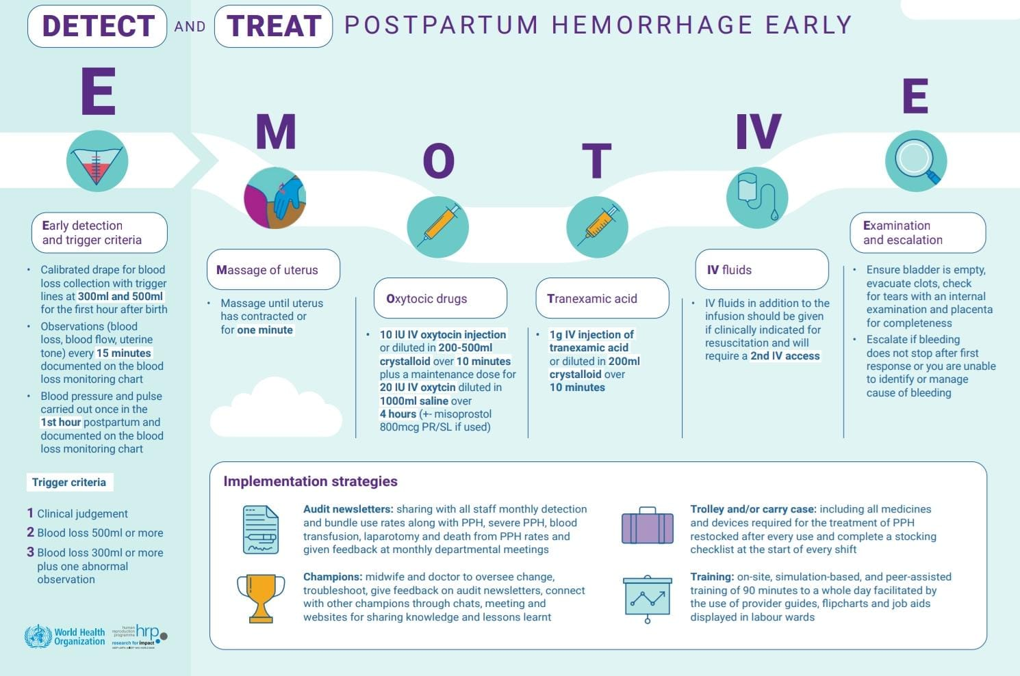
EMOTIVE Bundle

Slide 3
Escalate - 6th component
Evacuate bladder
Evacuate clots
Examine Genital tract to rule out vaginal and cervical tears
Examine Placenta for completeness

Slide 4
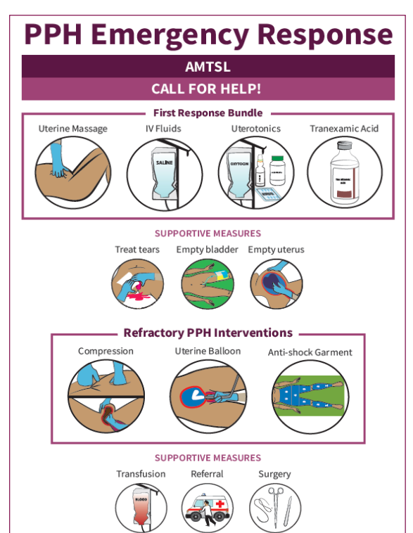

Slide 5
Escalate
If bleeding does not stop or health provider not able to identify or manage cause of bleeding – Take it from Suvarnas ppt time frame??
Escalate to manage refractory cases

Slide 6
Response to Refractory PPH
Compressive measures (aortic compression or bimanual uterine compression)
Intrauterine balloon tamponade
Non-pneumatic antishock garment
A continuing dose of uterotonics (e.g. oxytocin diluted in isotonic crystalloids) and a second dose of tranexamic acid should be administered during the application of this bundle

Slide 7
Bimanual Uterine compression (not massage)
Involves one hand internally putting upward pressure on the uterus, while the external hand puts pressure on the fundus through the abdomen
The uterus should be kept compressed until medical support arrives or during transport to the operating theater or to a higher-level facility
Occasionally bimanual compression alone will stop the haemorrhage and no other haemostatic measures will be necessary.

Slide 8
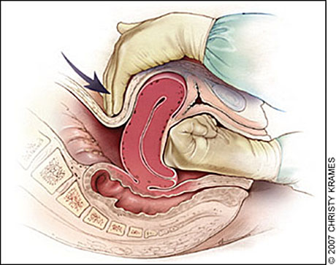

Slide 9
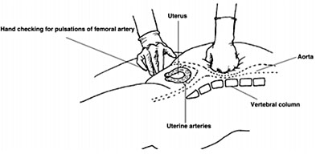
Aortic compression
Concept is to maintain blood flow in the superior portion of the body, while preventing blood flow in the inferior portion; thus keeping the vital organs perfused
Operator stands to the right of the patient and places the left fist on the superior left side of the patient’s umbilicus, while simultaneously palpating for femoral pulses with the right hand
Absence of femoral pulse confirms adequate compression

Slide 10
Advantages and Limitations
Can be performed by anyone
Sterile gloves- Only supplies necessary
Requires operators to use both hands
Uncomfortable to the patients and tiring to the provider
May be difficult to sustain adequate pressure over long periods of time

Slide 11
NASG- Nonpneumatic antishock garment
Low-technology, affordable, first-aid compression device for the management and stabilization of women with hypovolemic shock due to PPH and management of refractory PPH
Temporary measure to maintain haemodynamic stability to allow other definite interventions like transfer, blood transfusion and surgery or used to reverse shock whern other methods have failed

Slide 12
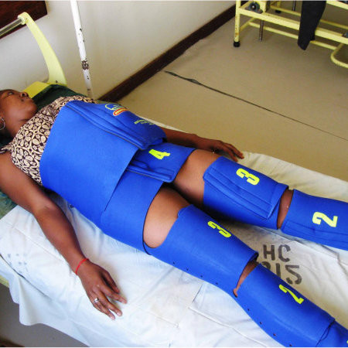
NASG
Lightweight, lower body compression device comprising six articulated neoprene and hook-and-loop fastener segments that provide lower body circumferential counterpressure to improve cardiac output and blood pressure
Apply NASG starting at the ankles and to remain in place until source of bleeding found, and bleeding decreased to 25–50 ml/h
The 20-40 mm Hg pressure applied increases cardiac output and the central circulation, allowing an increased distribution of blood flow to vital upper body organs (heart, lung, brains) and contributing to a rapid recovery from shock

Slide 13
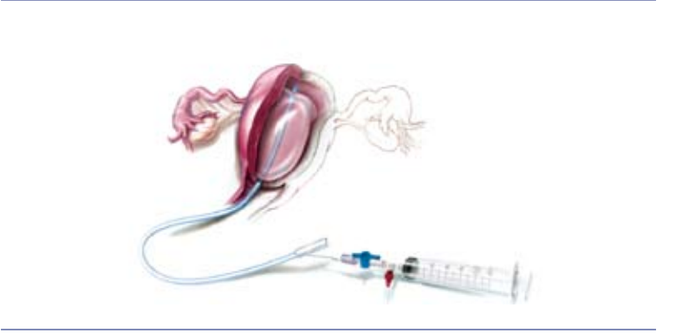
Tamponade
Diagnostic and therapeutic tool
Should be considered early when emergency measures for management of PPH are initiated after ruling out a uterus tear and performed by trained and competent health care providers.
Has proven to be an effective nonsurgical technique

Slide 14
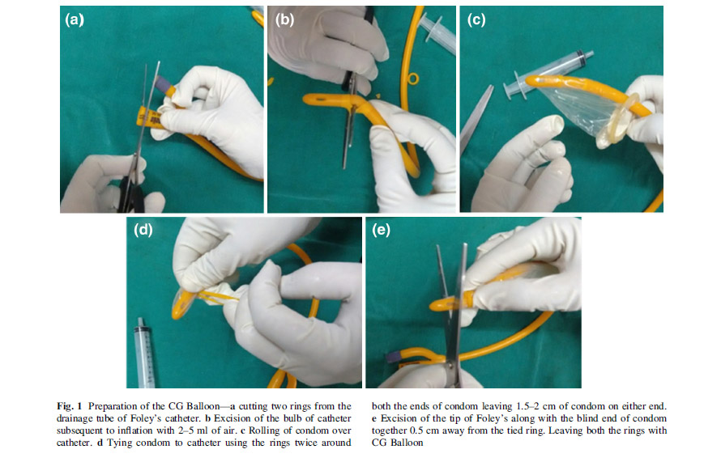
Uterine balloon devices can be divided into two groups:
Fixed volume devices:
  Condom uterine balloons , Bakri balloon, Rusch balloon, and Ebb system
Free flow devices:
  the glove balloon, Ellavi UBT, and Zukovski balloon. The glove and Ellavi balloons allow intrauterine pressure control according to systolic blood pressure. The Zukovski balloon uses 50 cm (3.8 cmHg) pressure for inflating the balloon

Slide 15
Mechanism of action
Stimulation of receptors by the device which in turn stimulates Uterine contraction
Direct application of hydrostatic pressure against the bleeding sinuses
FIGO recommends Uterine balloon tamponade as an effective nonsurgical technique which if used by a properly trained person can improve survival in women with PPH
Can be combined with compression sutures

Slide 16
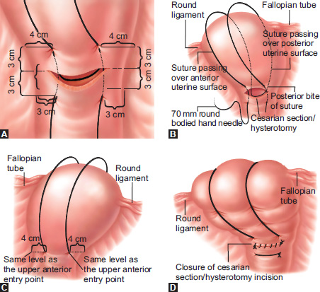
Other interventions
Uterine artery embolization- Effective in cases of PAS
Compression sutures – B Lynch, Hayman and Pereira- can be combined with tamponade
Uterine artery ligation- Simple, popular and easy to perform
Bil Internal Iliac artery ligation- Rapid and effective way, but needs skilled surgeons
Hysterectomy- Usually the last resort but effective as the main line in PAS

Slide 17
Blood and blood products
Timing important
Underestimation of blood loss
Massive transfusion Protocol
Optimal blood replacement- Multicomponent therapy (1:1:1)
PRBC, FFP, and PLT are applied in a 1:1:1

Slide 18
Take home…
E-MOTIVE - Early detection of PPH and treatment using WHO first response bundle
Use of a calibrated drape for detection
Bundle of treatments
  Uterine massage
  Oxytocics and Tranexamic acid IV fluids
  Escalation of treatments if refractory PPH
60% reduction in severe PPH
The median blood loss, the need for postpartum blood transfusion, and the number of maternal deaths also reduced

Slide 19
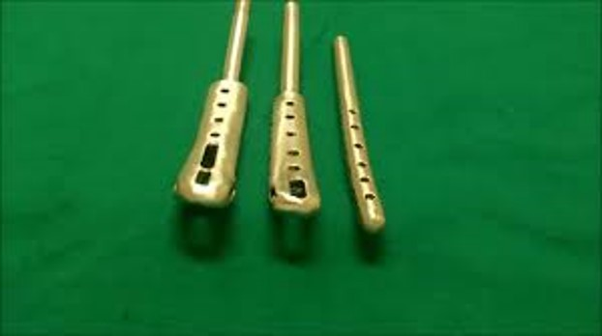
Novel methods
Vacuum suction cannula system can be used and has been tried successfully for atonic PPH
After insertion of the cannula into the uterine cavity, when negative pressure is applied, soft cervical tissues get sucked into the small holes of the cervical portion of the cannula and become adherent
Indian Innovations e.g suction canula have been developed with very good success rates
Panicker’s vacuum suction haemostatic device for treating post-partum haemorrhage. J Obstet Gynaecol India. 2017;67(2):150–1. FOGSI updated Guidelines on PPH 2022.
Samartha Ram H, Shankar Ram HS et.al. ‘Vacuum retraction of uterus for the management of atonic postpartum hemorrhage’ IOSR Journal of Dental and Medical Sciences e-ISSN:2279-0853, plSSN:2279-0861, Vol 13, Issue 11 Ver.II

