Slide 1
OXYTOCIC DRUGS (‘O’ of EMOTIVE )

Slide 2
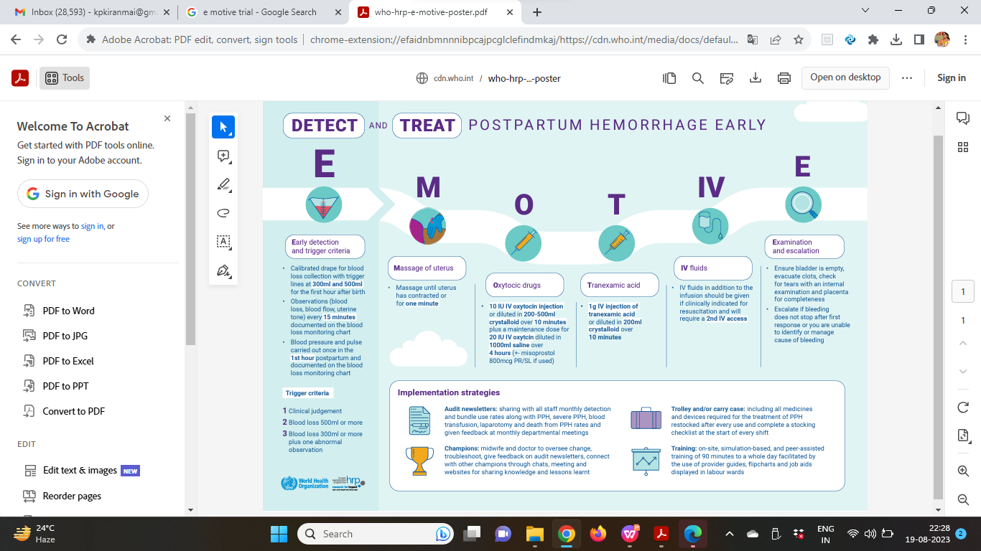

Slide 3
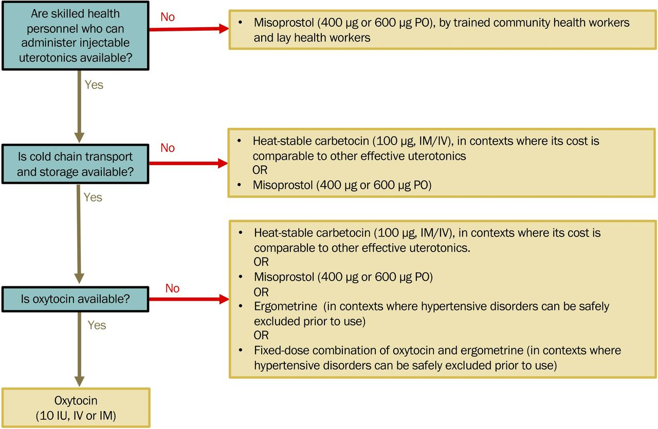
Which Oxytocic to use for prevention of PPH ?
Contextual considerations in selecting a uterotonic for postpartum haemorrhage prevention (only quality-assured medicines should be used regardless of which uterotonic option is selected) IM, intramuscular; IV, intravenous.

Slide 4
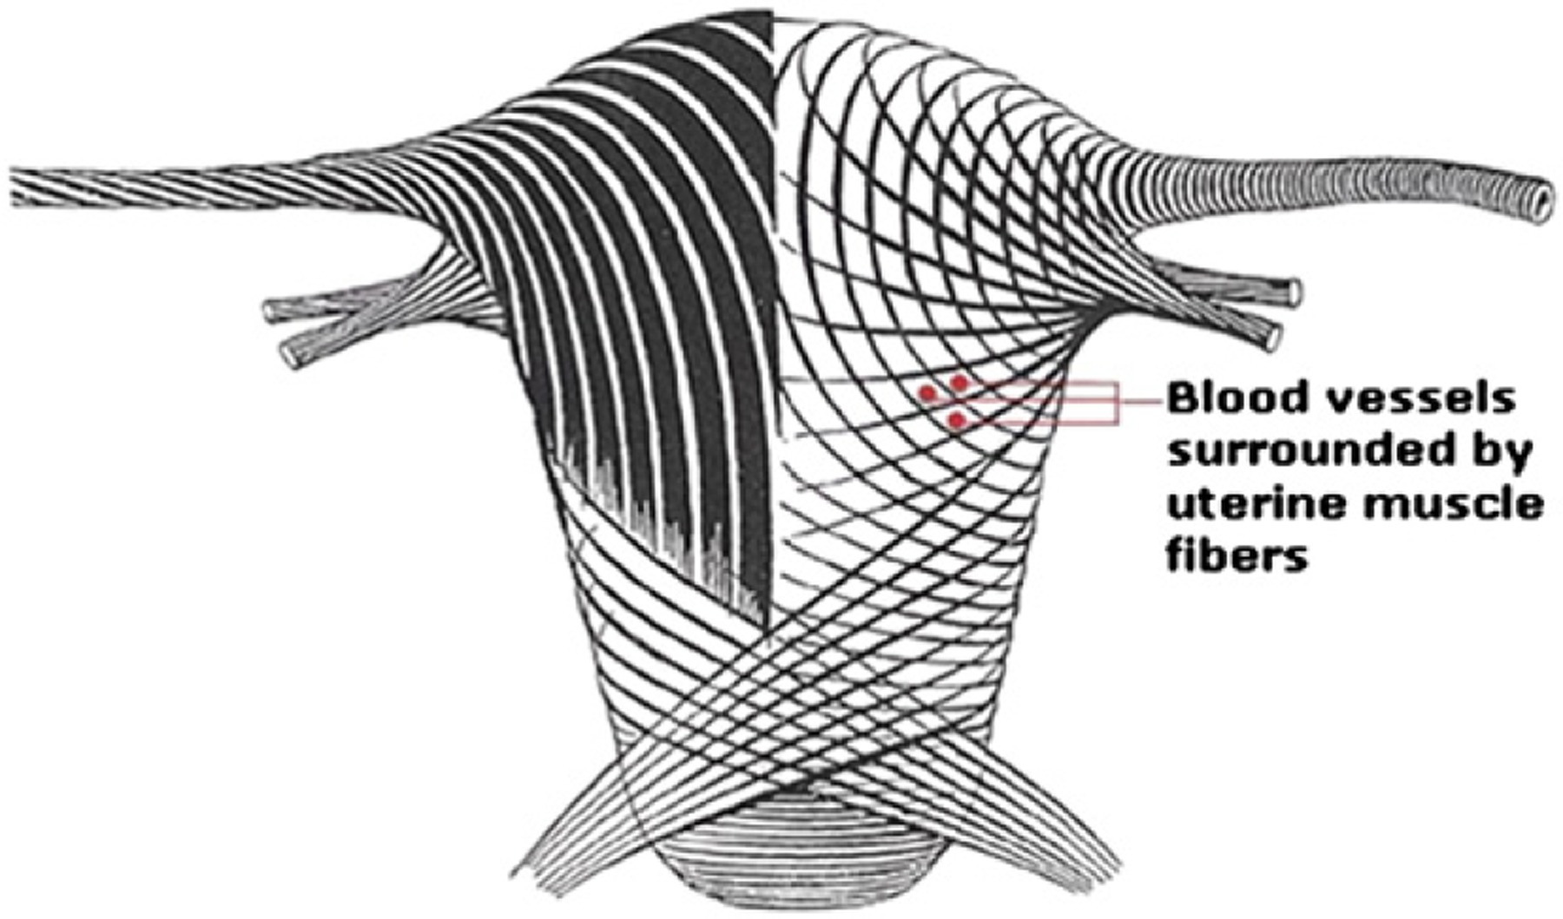
Oxytocic agents prevents PPH by causing effective uterine contractions and retraction and thus ensuring living ligature
Eur J Anaesthesiol 2023; 40:29–38.

Slide 5

Oxytocic drugs
Oxytocics are drugs of varying nature that have the power to stimulate the contraction of uterine muscles
Hence they are also known as Uterotonics
Introduction of Oxytocic drugs for treatment of PPH has been considered as one of the most enduring achievements of modern science
Uterotonics are considered the first‐line treatment for uterine atony
Intravenous oxytocin is usually the preferred drug and route of administration

Slide 6
Oxytocin Physiology & Pharmacology
Posterior pituitary
Oxytocin
prostaglandin intracellular calcium ion levels in myometrial cells
Rhythmic contractions of the upper myometrial segment
Spiral arteries are constricted, and uterine blood flow is reduced
Number of myometrial oxytocin receptors varies by individual
Uterine sensitivity and response to oxytocin administration also varies
Oxytocin is prepared synthetically
The plasma half-life of oxytocin ranges from 1 to 6 minutes

Slide 7
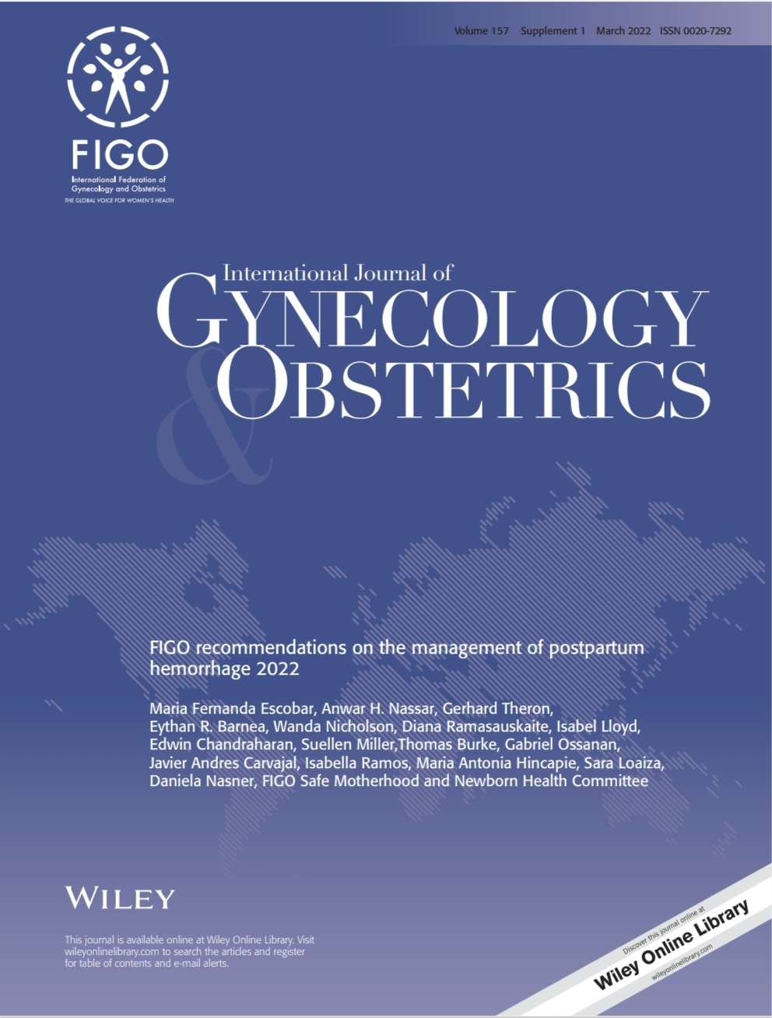
Oxytocic drugs in PPH -Evidence
FIGO recommendations for management of PPH 2022
Uterotonics are considered the first line treatment for uterine atony
Intravenous oxytocin alone is the recommended first line uterotonic drug for treatment of PPH
When IV oxytocin is not available or if the bleeding does not respond to oxytocin the use of an additional drug
Intramuscular ergometrine
Oxytocin Ergometrine fixed dose ,
Injectable Prostaglandins or.Misoprostol are recommended

Slide 8
Oxytocic drugs in PPH -Evidence
PPH Prevention and Management: FOGSI Updated PPH Guidelines 2022
Oxytocin†: 20 to 40 IU in 1 L normal saline, infuse 500 mL over 10 minutes then 250 mL per hour
Prostaglandin F2a 250 mcg IM
Methylergometrine (0.2 mg IM/IV) every two to four hours
Misoprostol: 800 to 1,000 mcg rectally or 600 to 800 mcg sublingually or orally
Carbetocin (100 mcg IM/IV)# only for prevention
Oxytocin should be used as a first-line agent, with other agents added only if needed to control hemorrhage.

Slide 10
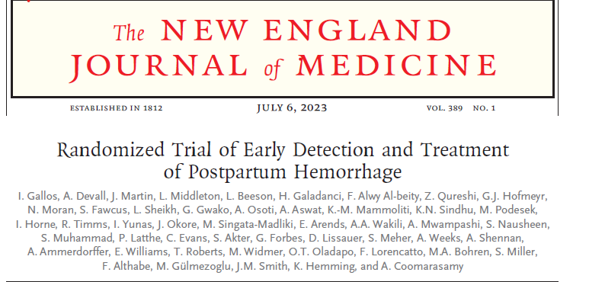
EMOTIVE TRIAL 2023
Oxytocic drugs in PPH -Evidence
IV Oxytocin 10 IU
Injected slow IV
Infused as diluted in 200–500 ml crystalloid administered over 10-min period,
OR
+
20 IU IV oxytocin diluted in 1000 ml saline administered over 4-hr period
+/-
Misoprostol 800 μg PR/SL

Slide 11

Uterotonics /Oxytocin as part of First Response BUNDLE
UTEROTONICS/ OXYTOCIN

Slide 12
Adverse effects of Oxytocin
These side-effects are generally related to the maternal condition, mode of delivery, dose, and route of administration
The first large systematic review and meta-analysis of 61 RCTs based on 68834 participants assessed 27 side-effects of oxytocin for the prevention of PPH, showed that oxytocin could decrease the risk of shivering, fever, and diarrhea, and did not show evidence of an increased risk of other side-effects
Vomiting, nausea, shivering and fever are the most frequent side-effects encountered when oxytocin is used for the prevention of PPH
Other side-effects -
  Gastro-intestinal disorders (diarrhea, metallic taste, and abdominal pain),
  Heart disorders (arrhythmias and palpitations),
  Blood system disorders (anemia and leukocytosis),
  Vascular disorders (flushing, hypotension, and hypertension),
  Respiratory disorder (dyspnea, wheezing, and nasal congestion),
  Nervous system disorders (headache, and dizziness) and
Other general disorders (pruritis, sweating, backache, chills, xerostomia, chest pain and arm pain)
Yanfei Zeng etal Side-effects of oxytocin in postpartum hemorrhage: a systematic review and meta-analysis Am J Transl Res. 2022; 14(3): 1934–1951
These side-effects are generally related to the maternal condition, mode of delivery, dose, and route of administration
The first large systematic review and meta-analysis of 61 RCTs based on 68834 participants assessed 27 side-effects of oxytocin for the prevention of PPH, showed that oxytocin could decrease the risk of shivering, fever, and diarrhea, and did not show evidence of an increased risk of other side-effects

Slide 13
Adverse effects of Oxytocin
Severe
  Cervical laceration / Uterine rupture / Intracranial bleeding / Afibrinogenemia / Retinal hemorrhage / Arrhythmia exacerbation / Ocular hemorrhage / Coma / Pulmonary edema Seizures / Water intoxication / Anaphylactoid reaction
Moderate
  Hypertonic uterine contractions / Premature ventricular contractions (PVCs) / Hypertension / Fetal bradycardia / Blurred vision / Hyperbilirubinemia / Jaundice
Mild
  Vomiting /Nausea

Slide 14
Contraindication for Oxytocin
Hypersensitivity to the compound
Uterine scar
Active cardiac / pulmonary/ hepatic / renal disease
Hypotension
Bronchial asthma

Slide 15
Adverse effects of Misoprostol
The most commonly reported adverse effects are generally mild and include
Shivering/chills,
Diarrhea,
Abdominal pain,
Hyperthermia,
Nausea,
Vomiting,
Flatulence,
Constipation,
Dyspepsia,
Headache,
Less reported mild side effects include syncope, lethargy, weakness, and vertigo
Moderate to severe reactions are less common and include hypotension, sinus tachycardia, fetal bradycardia, uterine contractions and pain, vaginal bleeding, edema, myocardial infarction, uterine rupture, cervical laceration, fetal death, pulmonary embolism, anaphylactoid reactions, and thrombosis
Turner JV, Agatonovic-Kustrn S, Ward H. Off-label use of misoprostol in gynaecology. Facts Views Vis Obgyn. 2015 Dec 28;7(4):261-264

Slide 16
Contraindication for Misoprostol
Misoprostol is contraindicated in those with previous allergic reaction or hypersensitivity to prostaglandin
Those at risk for gastric ulcers secondary to NSAID use
Turner JV, Agatonovic-Kustrn S, Ward H. Off-label use of misoprostol in gynaecology. Facts Views Vis Obgyn. 2015 Dec 28;7(4):261-264

Slide 17
TRANEXAMIC ACID and IV FLIUDS (‘T’ ‘IV’ of EMOTIVE )

Slide 19
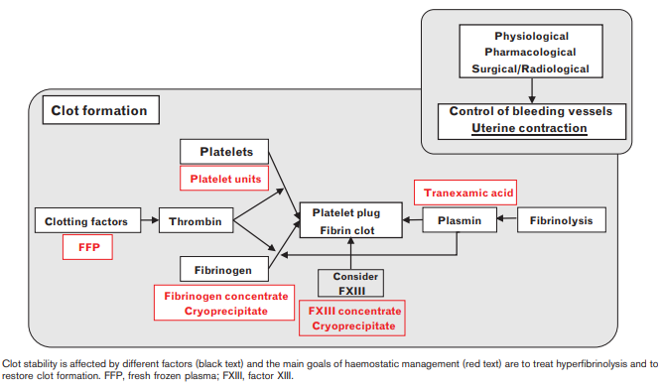
PPH: Hemostatic interventions
Eur J Anaesthesiol 2023; 40:29–38.

Slide 20
Tranexamic Acid
Tranexamic acid (TXA) is a synthetic analogue of the amino acid lysine
TXA forms a reversible complex that displaces plasminogen from fibrin resulting in inhibition of fibrinolysis and inhibition of the proteolytic activity of plasmin
Inhibits fibrinolysis by reducing the binding of plasminogen and tissue plasminogen activator (tPA) to fibrin.
Hyperfibrinolysis and fibrinogen depletion are common in the early stages of major postpartum bleeding,hence an antifibrinolytic drug is useful.
TXA offers an alternative way to support hemostasis.

Slide 21
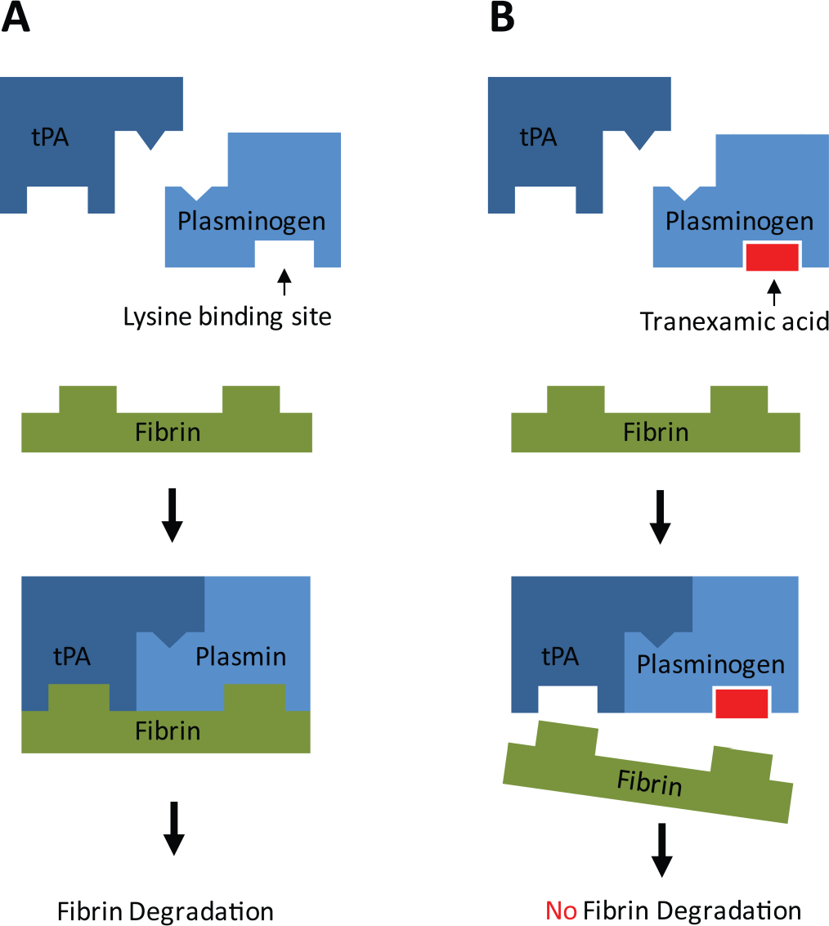
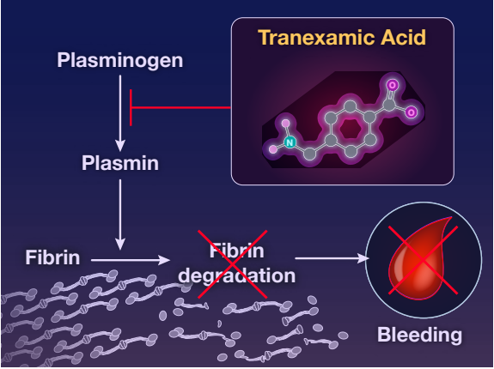
Tranexamic acid: mechanism of action
This ultimately stabilizes the fibrin matrix and reduces clot breakdown
Fig: N Engl J Med 2021; 384:1623-1634 DOI: 10.1056/NEJMoa2028788; Chauncey JM, Wieters JS. Tranexamic Acid. [Updated 2022 Jul 25]. In: StatPearls [Internet]. Treasure Island (FL): StatPearls Publishing; 2023 Jan-. Available from: https://www.ncbi.nlm.nih.gov/books/NBK532909/; Lecker, Irina. “Tranexamic Acid Modulation of Excitatory and Inhibitory Amino Acid Receptors: A Potential Mechanism for Postoperative Seizures.” (2015).
Notes:
reduces bleeding by inhibiting plasminogen from interacting with fibrin, thus reducing plasmin activation, and so reduces clot breakdown

Slide 22
Tranexamic Acid for treatment of PPH -Evidence
WHO | Updated WHO recommendation on tranexamic acid for the treatment of postpartum haemorrhage; | OCT 2017
FIGO | Joint statement of recommendation for the use of tranexamic acid for the treatment of PPH, | June 2021
WOMAN TRIAL |  | 2017

Slide 23
TRANEXAMIC ACID -EVIDENCE
TXA reduced death due to bleeding in women with PPH by 20%–30%
Not associated with an increase in adverse effects.
Reduced the incidence of laparotomy to control bleeding by 36% but..
Did not reduce hysterectomy rates.
WOMAN Trial

Slide 24
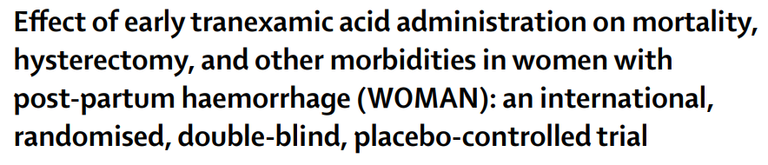
WOMAN
2017
Objective: To assess the effects of early administration of tranexamic acid on death, hysterectomy, and other relevant outcomes in women with post-partum haemorrhage.
20 060 women were enrolled
randomly assigned to receive
Tranexamic acid (n=10036)
Placebo (n=9985)
Randomised, double-blind, placebo-
controlled trial
Conducted in 193 hospitals across 21
countries
1 g iv tranexamic acid or matching placebo in addition to usual care. If bleeding continued after 30 min, or stopped and restarted within 24 h of the 1st dose, a 2nd dose of 1 g of tranexamic acid or placebo could be given
Lancet 2017; 389: 2105–16

Slide 25
WOMAN TRIAL
TRANEXAMIC ACID -EVIDENCE
Mortality was reduced in the TXA arm compared with placebo (1.5% vs. 1.9%; RR 0.81, 95% CI 0.65 to 1.00, P=0.045).
Benefit was most pronounced when TXA was given within 3 h of giving birth (mortality rate 1.2% in TXA vs. 1.7%; RR 0.69, 95% CI 0.52 to 0.91, P=0.008)
Conclusion:
Tranexamic acid reduces death due to bleeding in women with PPH with no adverse effects.
Tranexamic acid should be given AS SOON AS POSSIBLE ,WITHIN 3 HOURS after bleeding onset when used as a treatment for postpartum haemorrhage,
No evidence of any increased risk of thromboembolic events
Lancet 2017; 389: 2105–16; relative risk (RR)

Slide 26

FIGO ENDORSEMENT-TXA
Joint statement of recommendation for the use of tranexamic acid for the treatment of PPH, June 2021
FIGO does not recommend the use of TXA prophylactically, given the limited evidence in that regard.
FIGO recommends administration of tranexamic acid as soon as the diagnosis of PPH is made, as long as this is within 3 h postpartum.
One gram of tranexamic acid, intravenously over 10 min is to be given regardless of the cause of PPH.
If bleeding continues after 30 min or stops and restarts within 24 h after the first dose, a second dose of 1 g may be given.

Slide 27
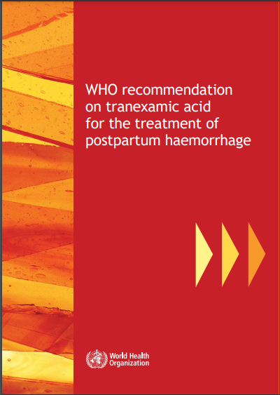
Updated WHO recommendation on Tranexamic acid for the treatment of Postpartum Haemorrhage;
Tranexamic acid Dose
First Fixed dose of 1g (100 mg/mL) intravenously (IV) at 1 mL per minute( over 10 minutes),
Second dose of 1 g IV
if bleeding continues after 30 minutes, or
if bleeding restarts within 24 hours of completing the first dose
Clinically diagnosed Postpartum Haemorrhage -Vaginal birth or Caesarean section.
Early use of intravenous Tranexamic acid
As soon as possible
Within 3 hours of birth
In addition to standard care
Strong recommendation, moderate quality of evidence
Time of birth is the Reference point for the start of the 3-hour window for starting TXA administration is .
It is critical that TXA is given as soon as possible to achieve clinical benefits
OCT 2017
WHO recommendation on tranexamic acid for the treatment of postpartum haemorrhage. Accessed via https://apps.who.int/iris/bitstream/handle/10665/259374/9789241550154-eng.pdf- on 24th May 2023

Slide 28
Tranexamic acid -Evidence
“WHO recommended TXA be given immediately after PPH diagnosis, along with uterotonic drugs.
The ACOG recommended that TXA be administered when initial therapies fail.
Survival benefit of TXA decreased by 10% for every 15 min of treatment delay²
Waiting to see if initial therapies fail is likely to lead to delayed administration and reduce benefits of TXA treatment. Regardless of cause of bleeding, waiting to see if uterotonics fail can only lead to delayed TXA treatment, placing mothers at increased risk of consumptive coagulopathy”¹
Am J Obstet Gynecol MFM. 2023 Feb;5(2S):100722. doi:10.1016/j.ajogmf.2022.100722; 2 -International Journal of Obstetric Anesthesia, 48, 103206. doi:10.1016/j.ijoa.2021.103206, 3- Eur J Anaesthesiol 2023; 40:29–38. ; American College of Obstetricians and Gynecologists - ACOG

Slide 29
Updated WHO recommendation on Tranexamic acid for the treatment of Postpartum Haemorrhage - FAQs
TXA administration beyond 3 hours after birth -
Administration of TXA should be considered standard practice or additional treatment
TXA should be used in all cases of PPH, regardless of whether the bleeding is due to genital tract trauma or other causes -
The use of TXA should be avoided in women with a clear contraindication to antifibrinolytic therapy (including TXA)
This recommendation applies only to IV use
TXA should be recognized as a life-saving intervention and be made readily available for the management of PPH in settings where emergency obstetric care is provided.
does not confer any clinical benefit
As part of the Standard PPH Treatment Practice
YES
YES
YES
YES
WHO recommendation on tranexamic acid for the treatment of postpartum haemorrhage. Accessed via https://apps.who.int/iris/bitstream/handle/10665/259374/9789241550154-eng.pdf- on 24th May 2023

Slide 30

The 21st edition of the WHO Model List of Essential Medicines issued in June 2019, added heat stable carbetocin and tranexamic acid (TXA) to the core list of medicines for reproductive health
Uterotonics and TXA are pivotal for management of postpartum haemorrhage (PPH), which continues to be the leading cause of maternal deaths in most low-income countries
Gill R, et al. BMJ Global Health 2019;4:e002150. doi:10.1136/bmjgh-2019-002150

Slide 31
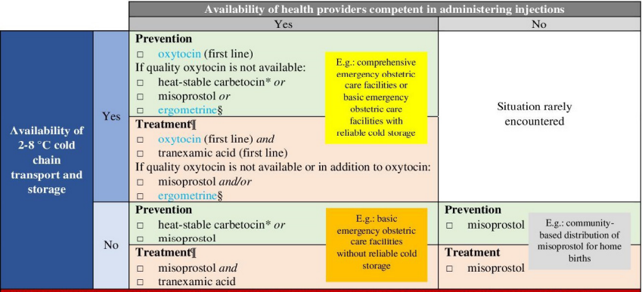
Tranexamic acid in PPH: Place in Therapy
BMJ Global Health 2022;7:e008913. doi:10.1136/ bmjgh-2022-008913

Slide 32
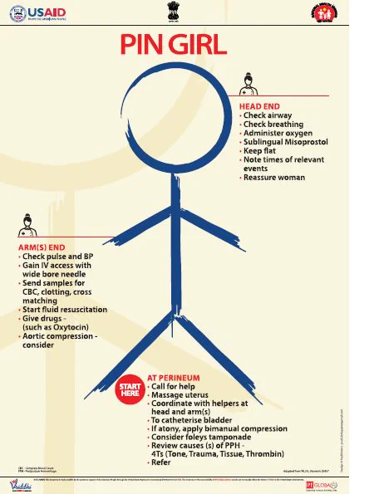
E M O T IV E
Oxytocics
Tranexamic acid
IV FLUIDS
Estimate blood loss
Massage
Examination and Escalation-compression, Balloon

Slide 33
Adverse reactions to TXA
Greater than 10%: headache (oral: 50%), abdominal pain (oral: 20%), back pain (oral: 21%), musculoskeletal pain (oral: 11%),nasal signs and symptoms (oral: 25%; including sinus symptoms).
1% – 10%:fatigue (oral: 5%), anemia (oral: 6%), arthralgia (oral: 7%), muscle cramps (oral: ≤7%), muscle spasm (oral: ≤7%).
Less than 1%: allergic dermatitis, allergic skin reaction, anaphylactic shock, anaphylactoid reaction, anaphylaxis, cerebral thrombosis, chromatopsia, conjunctivitis (ligneous), deep vein thrombosis, diarrhea, dizziness, hypersensitivity reaction, hypotension (with rapid intravenous injection), nausea, pulmonary embolism, renal cortical necrosis, retinal artery occlusion, retinal vein occlusion, seizure, ureteral obstruction, visual disturbance, vomiting.

Slide 34
Contraindications and Caution
Contraindications
Hypersensitivity to TXA or any component of the formulation.
TXA vials should be safely stored away from the vials of bupivacaine: concerns regarding accidental intrathecal administration of TXA, which has potentially fatal consequences, warrants high vigilance and caution

Slide 35

This study aimed to assess the cost-effectiveness of introducing TXA for PPH management in the Indian public health system
The addition of IV TXA is cost-effective in Indian public health settings
The intervention is likely to prevent 389 maternal deaths, 177 surgeries, and 128 ICU admissions per 100,000 PPH cases
Addition of tranexamic acid for primary PPH management, as recommended by WHO, is cost-effective in Indian public health settings
BMC Pregnancy Childbirth. 2023 Jan 6;23(1):9. doi: 10.1186/s12884-022-05308-4.

Slide 36
TXA - in PPH -Summary
TXA should be recognised as a life-saving intervention and be made readily available for the management of PPH in settings where emergency obstetric care is provided.
All cases of PPH regardless of whether the bleeding is due to genital tract trauma or other causes.
Initial dose of TXA should be administered as soon as possible to within 3 hours of birth,
A fixed dose of 1g administered IV over 10–20 minutes (100mg/ml), 1ml per minute
Infusion rate of more than 1ml/minute can cause hypotension.
Standard IV infusion equipment is required, as well as health care providers with sufficient training to safely administer IV bolus infusions.
Initial administration of TXA beyond 3 hours does not confer any clinical benefit.
a second dose of TXA of 1g (100mg/ml), IV at 1ml per minute should be administered if bleeding continues after 30 minutes, or if bleeding restarts within 24 hours of completing the first dose
The antifibrinolytic effect lasts up to 7–8 h in the serum.
Use of TXA should be avoided in women with a contraindication to antifibrinolytic therapy or thromboembolic disorder during pregnancy.

Slide 38
A PPH needs an IV access with two wide bore cannula gauze 14/16 immediately
Isotonic Crystalloid solutions are preferred to colloids
Urgent venepuncture (20 ml) for:
– group and screen
– full blood count
– coagulation screen, including fibrinogen
_x0001_pulse, respiratory rate and blood pressure recording every 15 minutes
_x0001_commence warmed crystalloid infusion.
The Royal College of Obstetricians and Gynaecologists RCOG Green-top Guideline No. 52

Slide 39
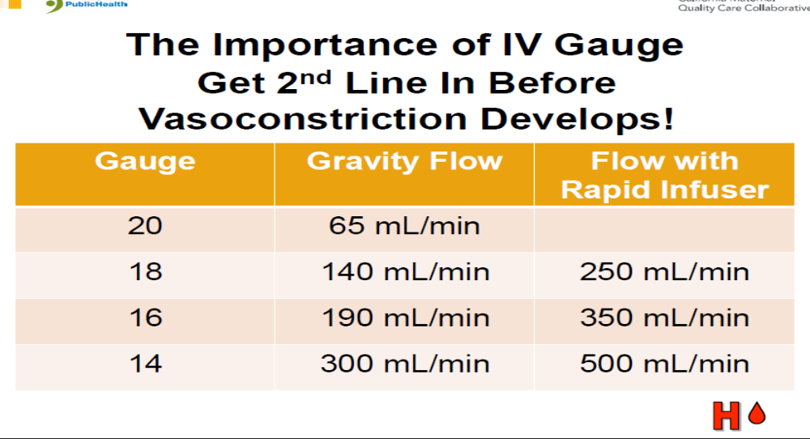

Slide 40
IV FLUIDS IN PPH - WHAT AND HOW
Fluid replacement is a crucial component of PPH treatment, although a dilutional coagulopathy may occur when large volumes of crystalloid, colloid or red cells are used with insufficient transfusion of fresh frozen plasma (FFP) and platelets
Traditionally, a total volume of 3.5 l of clear fluids (up to 2 l of warmed isotonic crystalloid as rapidly as possible, followed by up to a further 1.5 l of warmed colloid if blood is still not available) comprises the maximum that should be infused while awaiting compatible packed red cells
The Royal College of Obstetricians and Gynaecologists RCOG Green-top Guideline No. 52

Slide 41
IV FLUIDS IN PPH - WHAT AND HOW
While there is controversy as to the most appropriate fluids for volume resuscitation, the nature of fluid infused is of less importance than rapid administration and warming of the infusion.
The woman needs to be kept warm using appropriate measures to prevent hypothermia which in turn could exacerbate acidosis.
The Royal College of Obstetricians and Gynaecologists RCOG Green-top Guideline No. 52

Slide 42
OXYTOCIN IV Fluids and TXA as part of First Response BUNDLE
IV FLUIDS
OXYTOCIN
TRANEXAMIC ACID

Slide 43

PPH Emergency Response Commodities Checklist
First Response Bundle
2 IV administration kits (gloves, tourniquet, cleansing wipes, IV canula, IV tubing, connectors, gauze, tape)
Normal saline or Ringer’s lactate
Syringes and needles
Oxytocin readily available in the refrigerator
Confirm the refrigerator is working
TXA-TRANEXAMIC ACID
Misoprostol
Above drugs are not expired
Refractory PPH Interventions
UBT kits
NASG
Notes:
We have another tool for you to use as part of PPH Emergency Care. This is the PPH Emergency Response Commodities Checklist.
This checklist is a simple facility readiness tool that should be completed daily to ensure PPH Emergency Response commodities are available for use 24/7. As part of the setting up Emergency Response Areas toolkit, we will review the content/use of this checklist.

