Slide 1
MASSAGE ( ‘M’ of EMOTIVE )

Slide 2
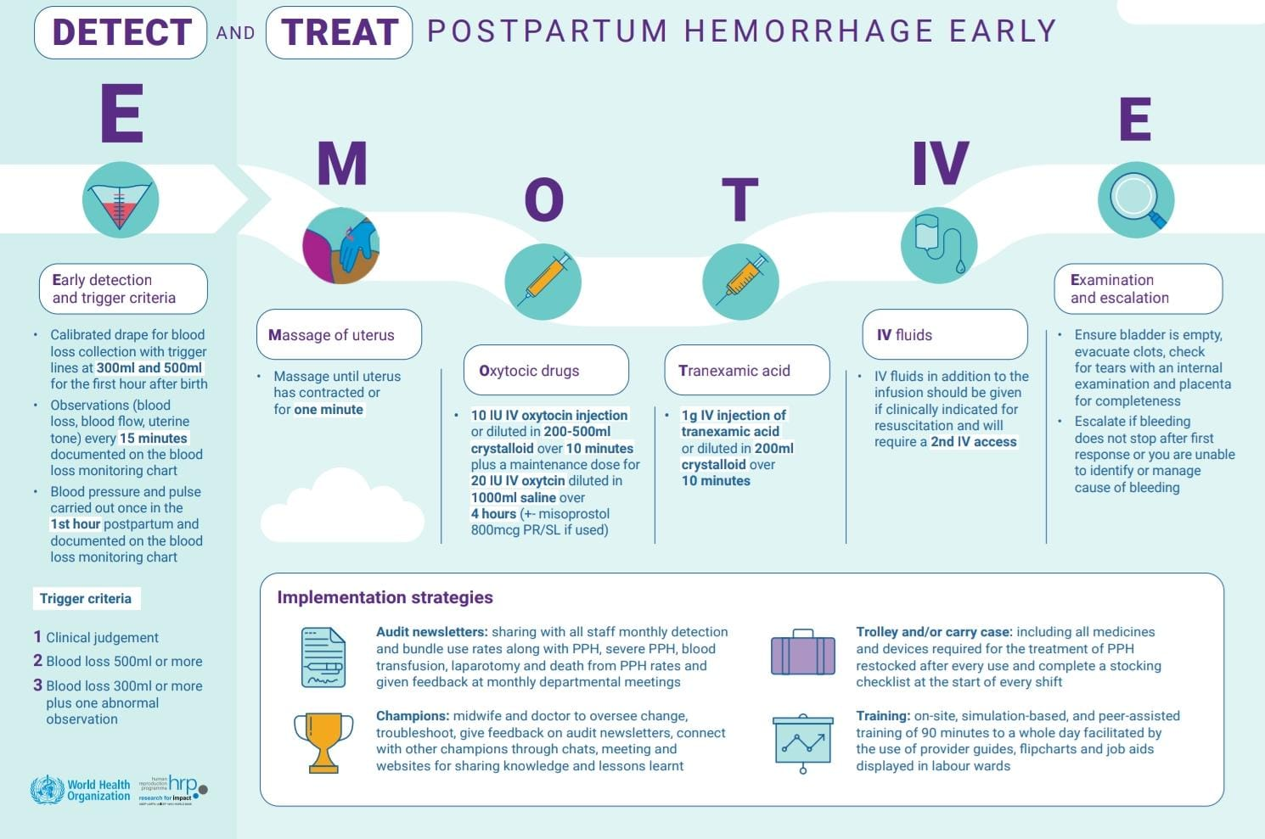
EMOTIVE Bundle

Slide 3
Learning Objectives
When to do ?
How to do ?
Who should do it?
How long to do ?
How does it help ?

Slide 4
When ?
A clinical care bundle is a set of discrete, evidence based interventions, administered concurrently, or in rapid succession, to every eligible person,along with teamwork, communication,& cooperation.
Once triggered, all bundle component must delivered

Slide 5
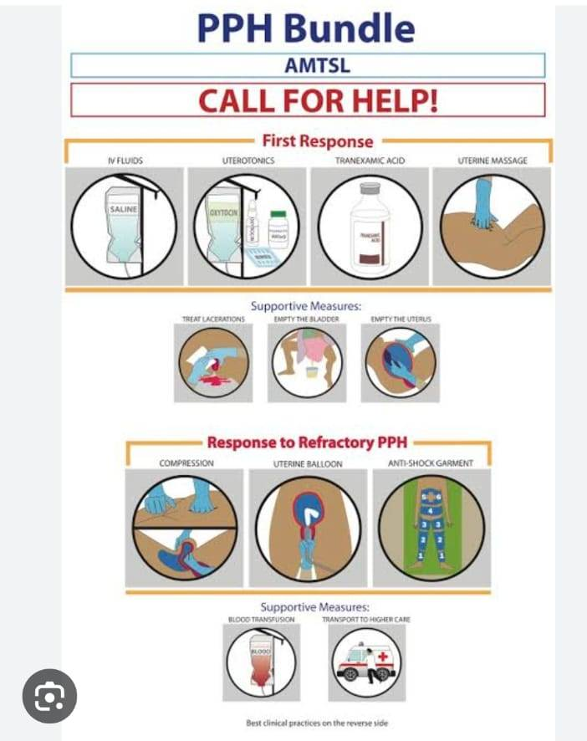

Slide 6
Uterine massage as a therapeutic measure is defined as the rubbing of the uterus achieved through the manual massaging of the abdomen
Typically sustained until the bleeding stops or the uterus contracts
Uterine massage should be started once PPH has been diagnosed

Slide 7
When ?
After birth of the baby
Before delivery of the placenta
or
If placenta has delivered and PPH diagnosed
The first response PPH bundle must be implemented at both the primary healthcare and hospital levels

Slide 8
How ?
Single hand ( Provider / self )
Bimanual per abdomen

Slide 9
Typically, after birth fundus is located around the umbilicus or a little below, and directly midline in the abdomen
Massage the fundus and monitoring for any bleeding associated with the rubbing.
Assessing and monitoring the bleeding at the same time

Slide 10
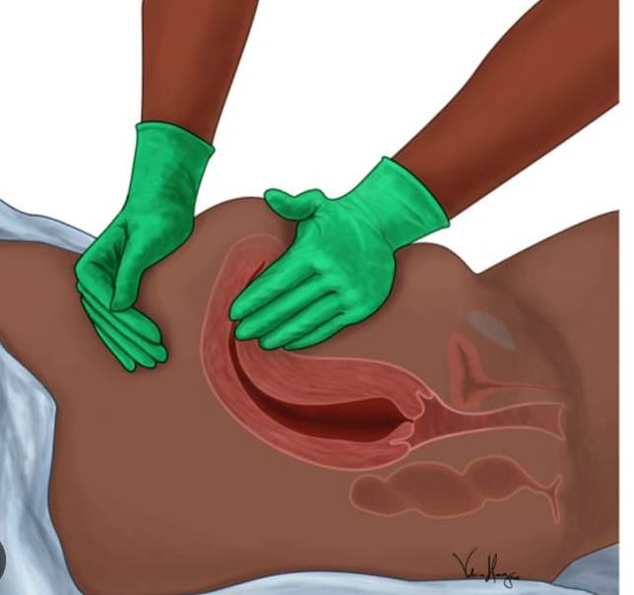
Uterine Massage

Slide 11
Who can do it ?
Skilled birth attendants who are trained to do the same

Slide 12
How long to do ?
Immediately postpartum every 15mins for the first hour
Every 30mins for the next hour

Slide 13
How does it help?
Helps to encourage the uterus continue to contract and prevent postpartum hemorrhage
After the placenta detaches and is delivered, the area where it was attached to the uterine wall bleeds –it helps in reduction of bleeding by contracting the large raw area
Helps in improving the tonicity and its maintenance

