Slide 1
EARLY DETECTION OF PPH ( ‘E’ OF EMOTIVE )

Slide 2
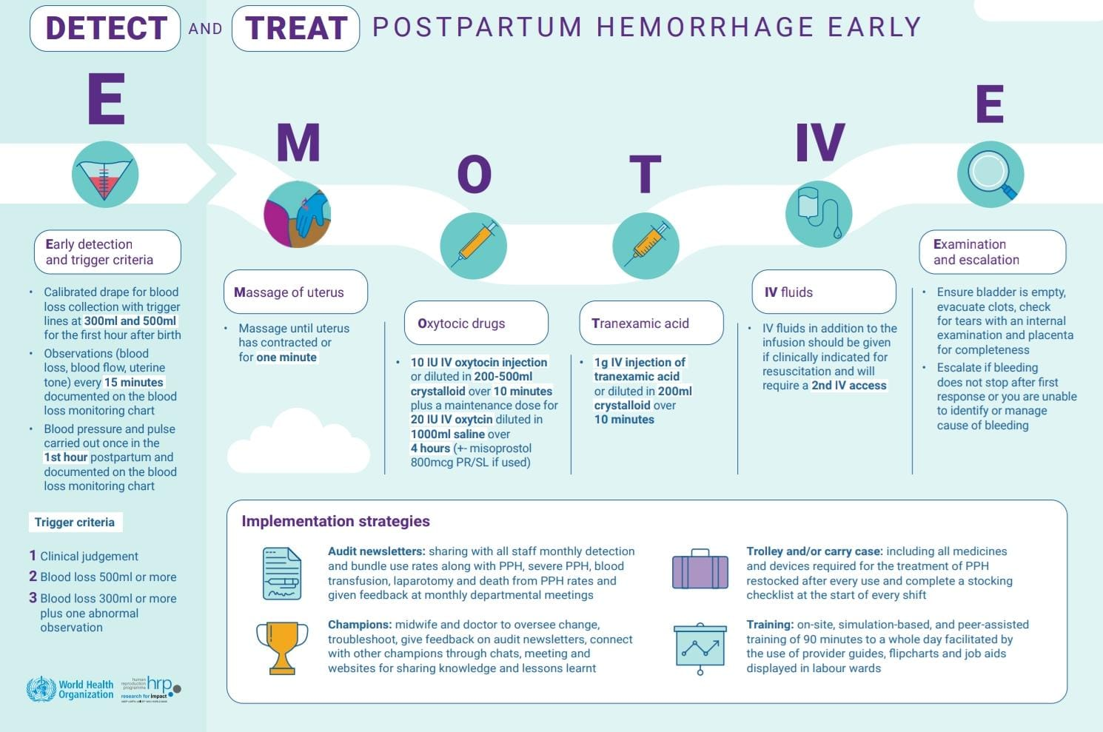
E- MOTIVE Bundle

Slide 3
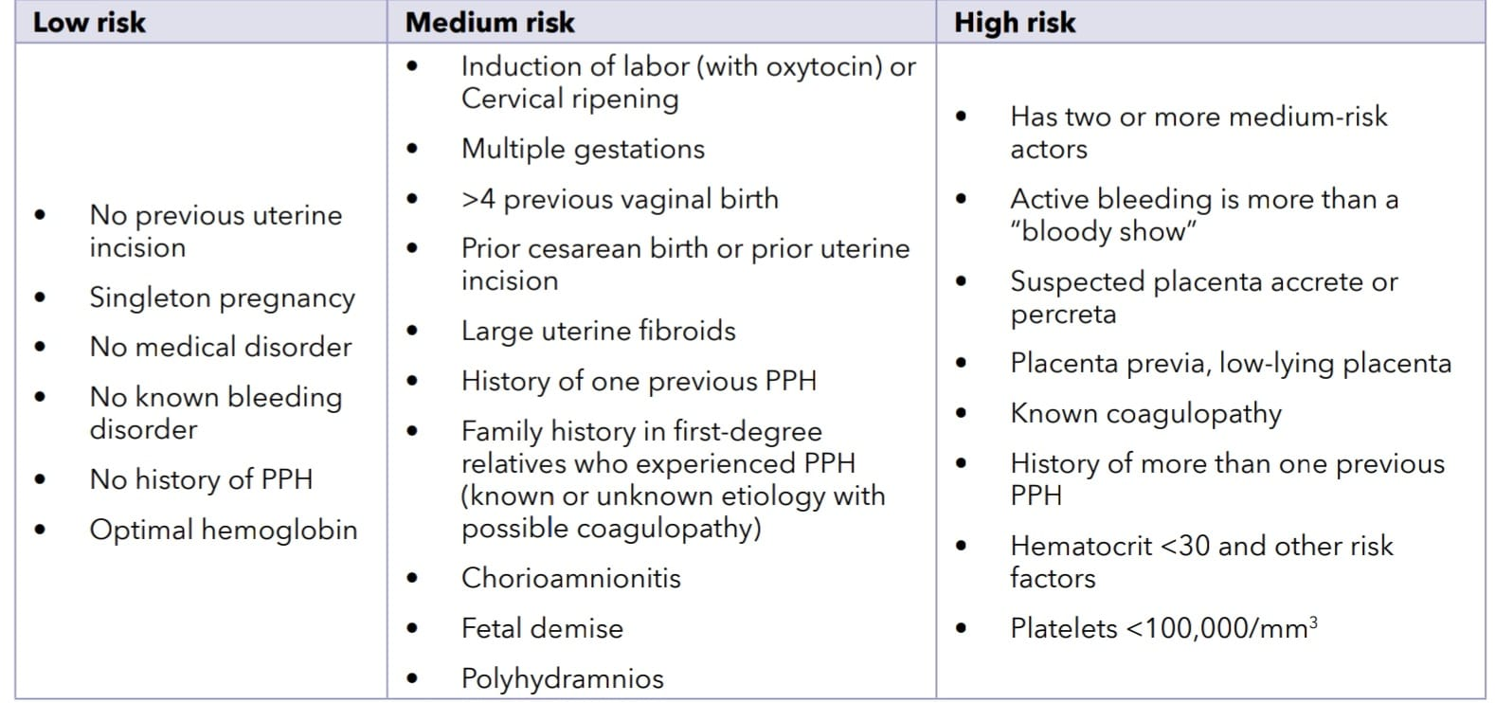
Risk Assessment tools for PPH*
Prenatal risk assessment and planning is highly recommended as early identification and management of patients will enable better outcomes.
* PPH Prevention and Management : Updated PPH Guidelines September 2022-FOGSI

Slide 4
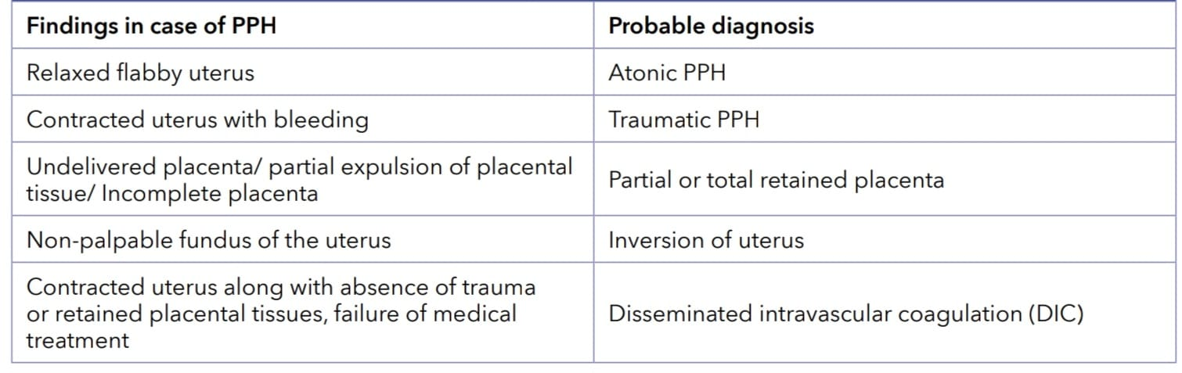
Clinical Features to Suspect PPH
A quick history and general physical and abdominal examination, speculum and vaginal examination, examination of placenta will help to identify the probable cause

Slide 5
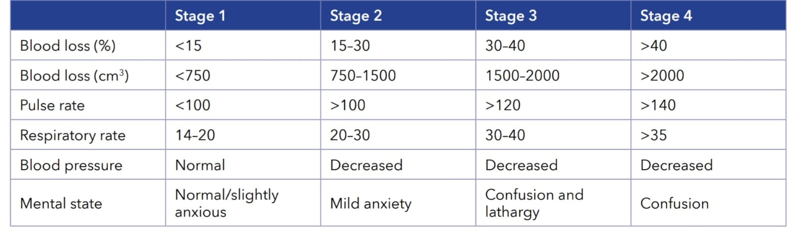
Stages of Hemorrhagic Shock
Clinical signs or symptoms of blood loss may be masked. They are present if there is considerable blood loss. Continuous assessment of vital signs, estimation of total blood loss is important intrapartum and postpartum.

Slide 6
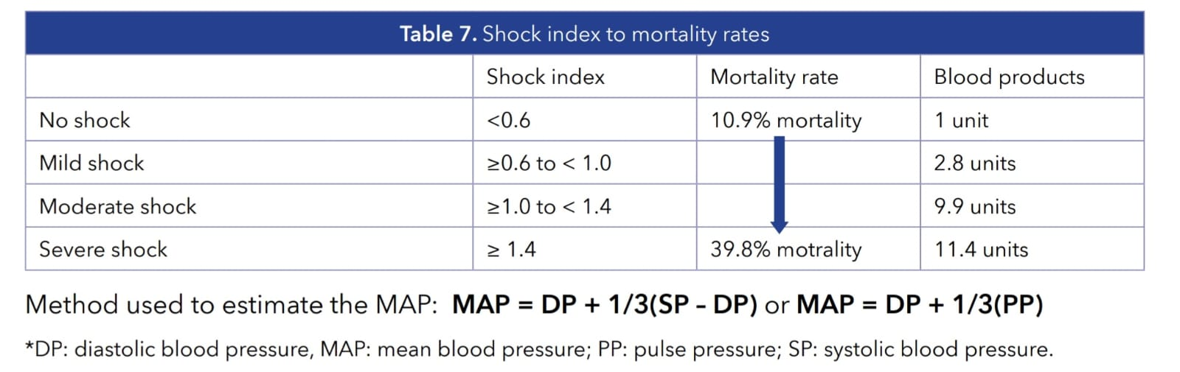
Modified Shock Index
The modified shock index is a bedside assessment to estimate hemorrhagic shock - defined as Heart rate (HR) to mean blood pressure (MAP), with a normal range of 0.5 to 0.7 in healthy adults.

Slide 7
RCT Study - The New England Journal of Medicine
An RCT was conducted for Early Detection and Treatment of PPH
80 hospitals (Kenya, Nigeria, South Africa, Tanzania) underwent randomization, 40 assigned to intervention group and remaining 40 to continue providing usual care.
Data was available from 78 hospitals.
Intervention included a calibrated blood-collection drape for early detection of PPH and a bundle of first-response treatments (uterine massage, oxytocics, tranexamic acid, IV fluids, examination, escalation), supported by implementation strategy (intervention group) –
E MOTIVE Intervention

Slide 8
RCT Study
Implementation was supported by several components, including use of trolleys or carry cases for PPH; simulation-based, on-site training; local champions (midwives and doctors who lead and support change in participating hospitals); and audit and feedback of actionable data to providers.
Early detection of PPH and use of bundled treatment led to lower risk of Primary outcomes like severe PPH, laparotomy for bleeding, or death from bleeding, than usual care among patients having vaginal delivery.

Slide 9
RCT Study
A primary-outcome event occurred 1.6% in the intervention group and 4.3% in the usual-care group (risk ratio, 0.40; 95% confidence interval [CI]).
PPH was detected in 93.1% of the patients in the intervention group and in 51.1% of those in the usual-care group
The risk of the primary outcome in the intervention group progressively decreased with time after randomization, from a mean of 3.8% during the baseline prerandomization phase to 1.1% by the last month of the implementation phase

Slide 10
METHODS OF BLOOD LOSS QUANTIFICATION

Slide 11
Quantification of Blood loss post partum
Objective Methods-
  Gravimetric Method
  Calibrated Plastic Sheet
  Use of Artificial Intelligence
Subjective-
  Visual Estimation

Slide 12
Quantification of Blood loss post partum - Objective
Gravimetric Method –
The gravimetric method is an indirect measurement of blood loss. Blood loss can be estimated by weighing surgical material contaminated with blood and subtracting the dry weights.
By summing up measured weight of blood and estimating amount (ml) of mixed liquids (e.g. blood, rinse liquid) in the suction container, the blood loss can be calculated with a conversion of 1 g = 1 ml blood.
The factors of increased dilution by amniotic fluid or rinsing lead to inaccuracy in the calculation
Comparison of common perioperative blood loss estimation techniques: a systematic review and meta‑analysis

Slide 13
Quantification of Blood loss post partum- Objective
Calibrated Collector Bag Method –
  The collector bag is placed under the woman’s buttocks immediately after the birth of the child and collects all mixed liquids (e.g. blood or amniotic fluid).
  At the bottom of the plastic foil there is a calibrated collector bag with a scale on which the current blood loss can be read.
  Easy to use, especially in resource-poor areas, in combination with a visual assessment can somewhat improve the quantification of the total blood volume, e.g. during a birth

Slide 14
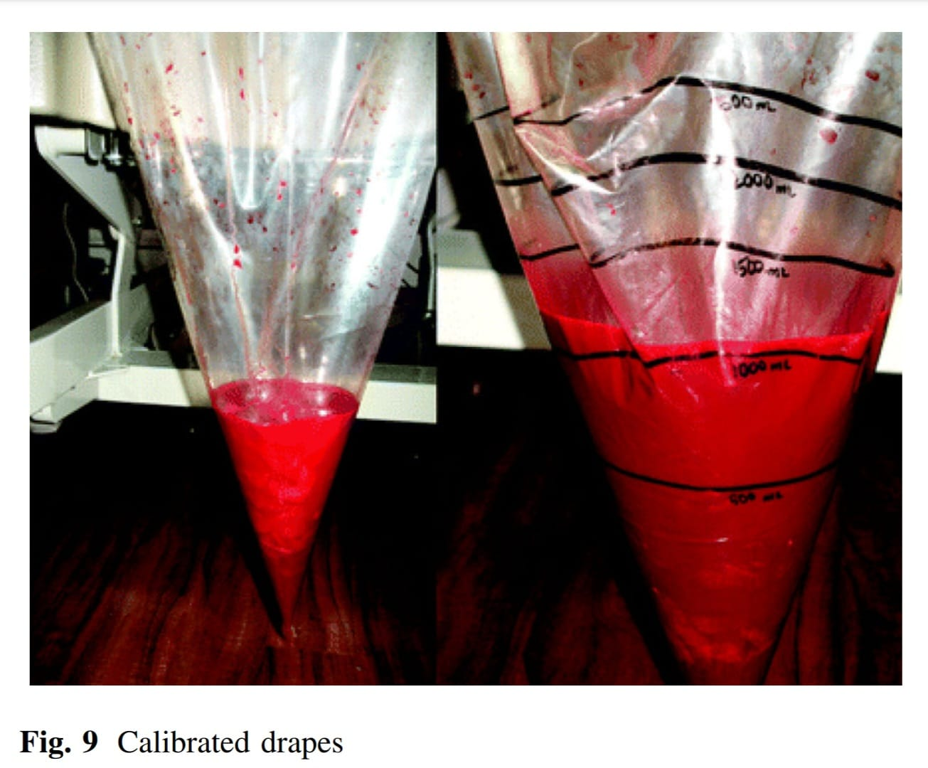
Quantification of Blood loss post partum- Objective
Quantification of Peri-partum Blood Loss: Training Module and Clot Conversion Factor - The Journal of Obstetrics and Gynecology of India (September–October 2016)

Slide 15
Quantification of Blood loss post partum- Objective
Use of Artificial Intelligence –
Smartphone App (Triton™) developed by Gauss Surgical Inc. calculates blood loss by taking photographs of used surgical gauze and canisters.
The colorimetric technique analyses photographic and geometric information from relevant areas, automatically filtering out effects of non-blood components mixed in each sponge and canister.
It calculates Hb mass present in gauze or canister from the image.
By entering the preoperative Hb-level, the blood loss can then be calculated.

Slide 16
Quantification of Blood loss post partum- Subjective
Visual Estimation-
Peri-partum blood loss is often not estimated correctly.
Blood drained during the second stage of labor is often not measured.
Absorbent material like bed sheet or drape used to cover mattress during delivery absorbs some amount of blood which is not estimated.
When clots are passed, there is no objective tool available which can assess exact whole blood loss. This is significant in cases of abruption/secondary PPH where blood loss has to be inferred from clots.

Slide 17
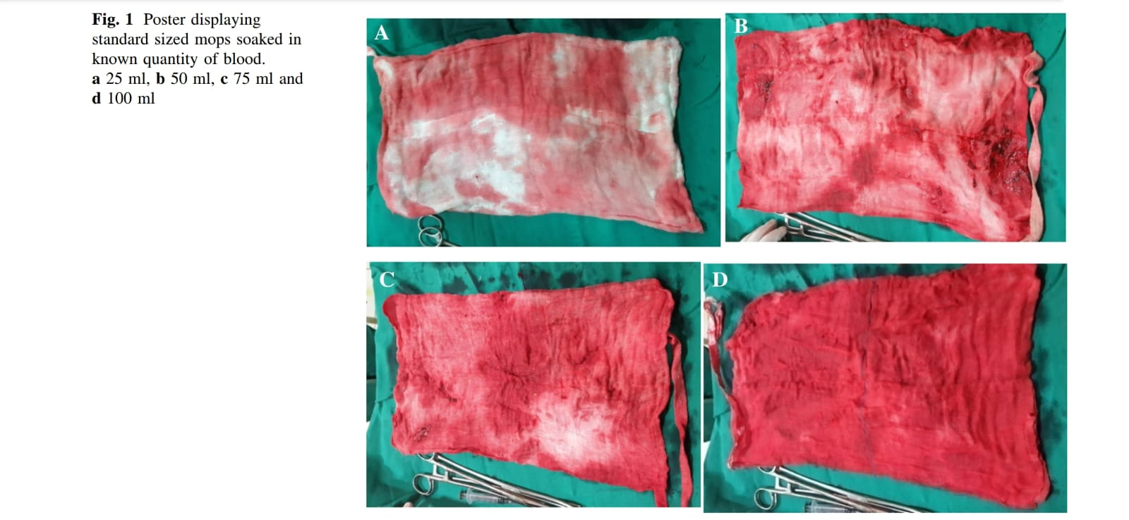
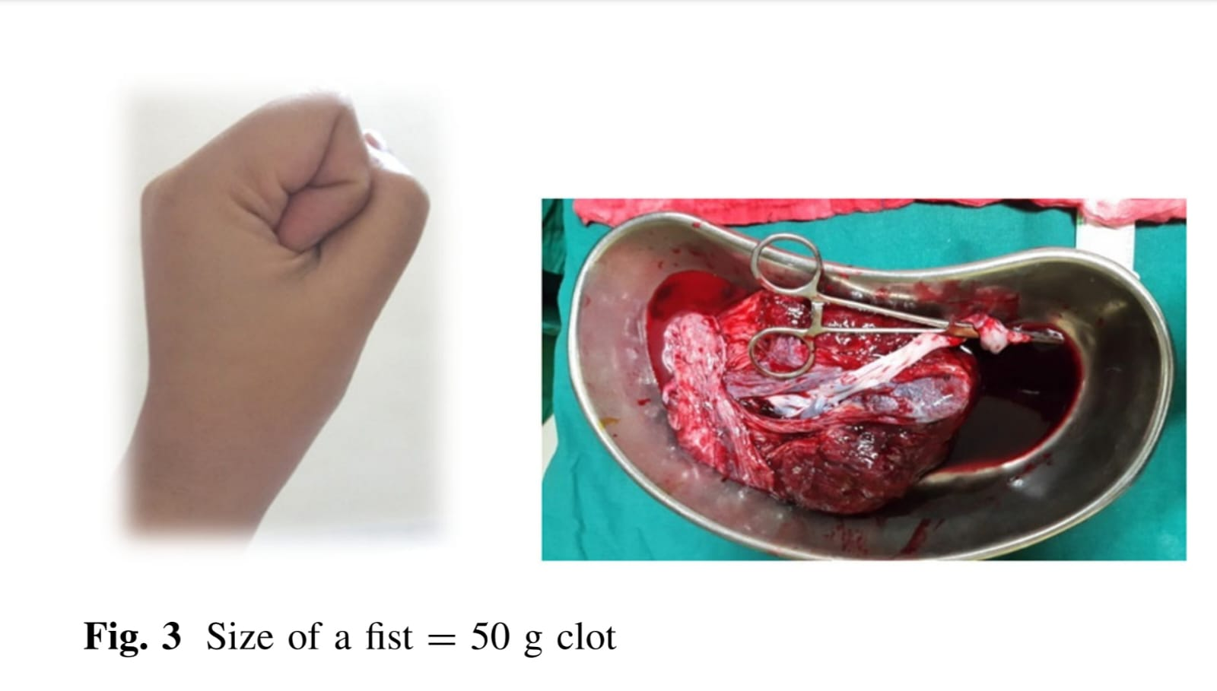

Quantification of Blood loss post partum- Subjective

Slide 18
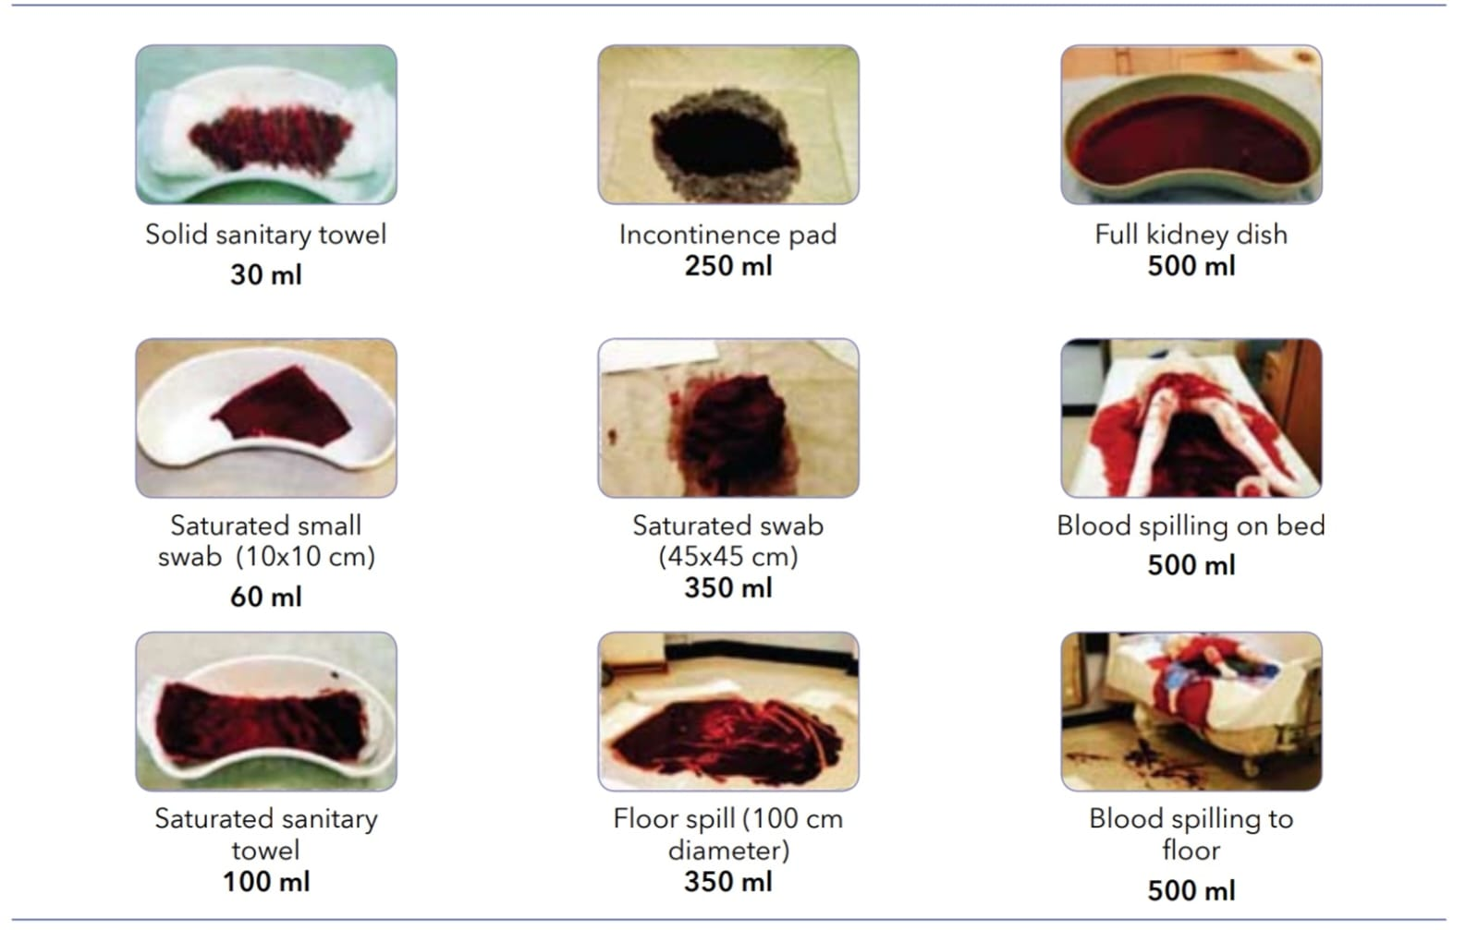

Quantification of Blood loss post partum- Subjective

Slide 19
Objective Quantification of Blood loss post partum Per Patient Proforma
Calibrated Plastic Drape (Up to 500ml acceptable) | Gravimetric Method (1g = 1ml blood) |  | Use of Artificial Intelligence (Colorimetric method)
 | Pre Delivery weight of drape | Post partum weight of drape
1.
2.
3.
4.
5.
6.

Slide 20
THANKYOU

