Slide 1
Post-Partum Haemorrhage
LDI NATIONAL CORE TEAM
Dr Hrishikesh Pai – Imm. Past President, Dr Madhuri Patel – Secretary General
LDI PPH CORE COMMITTEE
-Training materials prepared and curated by –
Dr Nandita Palshetkar, Dr Suvarna Khadilkar, Dr Kiranmai Devineni, Dr Seetha Pal, Dr Alka Pandey, Dr Uma Jaiswal, Dr Shyjus P, Dr Basab Mukherjee, Dr Niranjan Chavan, Dr Ameya Purandare, Ajey Bhardwaj

Slide 2
Leadership Development Initiative(LDI) - at a Glance
A FIGO - FOGSI project
Funder: The Bill and Melinda Gates Foundation
Countries: India, Bangladesh, Ethiopia, Kenya, Nigeria and Pakistan
Duration: 4 years
Goal: Improving maternal and newborn health outcomes

Slide 3
LDI CORE FOCUS:
LDI AIM:
Strengthening Leadership skills
Increase adoption of maternal and newborn interventions
Address the barriers
Building a gender-transformative approach to champion women in leadership
Effective Coverage of specific clinical interventions (PPH, Anaemia) at implementing facilities
What are the barriers to effective coverage of those interventions
Implementation of strategies to address those barriers and increase uptake and adoption of clinical interventions.
  Identify and Create a large pool of Leaders
  Leadership Empowerment
  Gender – Roadmap and LDI Voices
  Advocacy

Slide 4
Background and Introduction

Slide 5
Postpartum hemorrhage, defined as blood loss of at least 500 ml after birth,regardless of delivery-RCOG 2016, FOGSI 2015, EMOTIVE Trial
PPH Definition
Notes:
The clinical working definition must include: any bleeding from birth of a rate or amount that has the potential to deteriorate the condition of the mother and cause hemodynamic instability and shock. Notice we said, “has the potential to” deteriorate the condition of the mother. Women must be recognized and treated before they develop shock.
Key POINT: Women are dying or harmed because their PPH is under diagnosed and treated too late. This should always be on the providers mind.
What can be done to make sure we detect PPH on the postpartum ward early, before large blood loss or signs of shock develop?
Take time to discuss ideas with participants. These may include:
Careful postpartum vitals and monitoring, including checking for bleeding.
Counseling of patient and family on warning signs to report to staff
Staffing issues
Careful staff communication on all patients and particularly at risk patients coming from the labor ward
Protocols written and followed
Access to emergency teams

Slide 6
PPH is the most common cause of Maternal Death
…..accounting for about 35% of all maternal deaths worldwide.
…..incidence of PPH is 2% – 4% after vaginal delivery and 6% after a cesarean section.
PPH Prevention and Management : Updated PPH Guidelines SEPTEMBER 2022 -FOGSI

Slide 7
Some more painful facts - PPH related Maternal Deaths…
3% in all vaginal deliveries even with appropriate management
Global Incidence 11%
40% die at level 1 facilities – clinics, district hospital
50% of maternal deaths occur within 24 hours

Slide 8
PPH – Fastest of Killers ??
Uterus can bleed up to 800cc/min
Within 10 mins patient can collapse and die

Slide 9
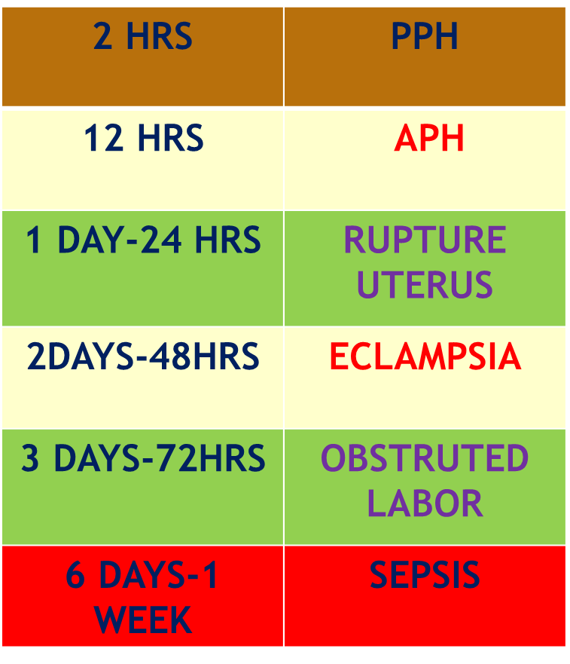
How Fast can PPH or Obstetric Haemorrhage lead to MD?
PPH recognized as QUICKEST OF KILLERS as early as 1991…yet MD is a reality !!
MD – Maternal Death
Ref: Maine D:Safe motherhood programmes: options and issues, centre for population and family health, 1991

Slide 10
And its Preventable ...
About 54%–93% of maternal deaths due to obstetric hemorrhage are preventable when standardized and multidisciplinary programmes are implemented.

Slide 11
Reasons for high mortality from PPH
FAILURE TO RECOGNISE EXCESSIVE BLOOD LOSS AND ESTIMATE AMOUNT OF BLOOD LOSS
FAILURE TO PROVIDE TIMELY TREATMENT FOR THE CAUSE OF PPH
FAILURE TO PROVDE EARLY AND ADEQUATE FLUID REPLACEMENT AND TREATMENT FOR SHOCK

Slide 12
Challenges in Management of PPH
Challenge ONE - estimation of blood loss
Challenge TWO - delayed or inconsistent use of interventions for the management of postpartum hemorrhage.
Treatments for postpartum hemorrhage are often administered in a sequential manner; a health care provider administers an intervention and waits to see whether it has had an effect before another intervention is administered.
However, postpartum hemorrhage is a time - critical condition, and delays in the use of lifesaving interventions can result in loss of life.
N Engl J Med 2023;389:11-21. DOI: 10.1056/NEJMoa2303966 EMOTIVE TRIAL

Slide 13
Priority…
STOP the bleeding
  before the patient develops coagulation problems
  organ damage from under-perfusion.
Conservative approaches should be tried first, rapidly moving to more invasive procedures if these do not work.
FIGO recommendations on the management of postpartum hemorrhage 2022

Slide 14
First 24hrs …Critical !
Most deaths due to severe PPH seem to occur during the first 24 hours after birth.
The transition of hemorrhage from the compensated to the decompensated stage is rapid and easily overlooked. Hence, prediction, early recognition, and intervention are crucial for lowering the risk of severe PPH or improving its clinical outcomes.

Slide 15
PPH and Anaemia
Anemia is strongly associated with postpartum haemorrhage and the risk of death or near miss.
Attention should be given to the prevention and treatment of anemia in women of reproductive age
Women 2 Trial

Slide 16
Impact of maternal age and still births in PPH
The odds of death increased with increasing age
The odds of death for mothers with stillbirths was five times higher than for those with live infants
  Over one third of the women who died (35.1%) gave birth to a stillborn baby, compared to less than one tenth (9.3%) of those who survived

Slide 17
Is there a Way Forward??
First, all should be done to avoid PPH
Reduce the need for expensive, lifesaving surgical interventions
Health workers at all levels of care (particularly in LMICs) need to have
  access to appropriate medications
  training in PPH prevention and management procedures
All attempts should be made to reduce PPH using cost-effective, resource-appropriate interventions.
FIGO recommendations on the management of postpartum hemorrhage 2022

Slide 18
Need for an Effective Implementation Tool
FIGO believes that the greatest impediment in the adoption of a given strategy is the absence of an effective implementation tool
PREVENTION
MANAGEMENT - GOAL- EARLY QUICK MANAGEMENT
PREVENT PPH FROM BECOMING MAJOR DECOMPENSATED

Slide 19
E MOTIVE TRIAL
Early detection of postpartum hemorrhage and use of bundled treatment led to a lower risk of the primary outcome, a composite of severe postpartum hemorrhage, laparotomy for bleeding, or death from bleeding, than usual care among patients having vaginal delivery. (Funded by the Bill and Melinda Gates Foundation; E-MOTIVE ClinicalTrials.gov number, NCT04341662.)
Randomized Trial of Early Detection and Treatment of Postpartum Hemorrhage I. Gallos, A. Devall, J. Martin, L. Middleton, L. Beeson, H. Galadanci, F. Alwy Al‑beity, Z. Qureshi, G.J. Hofmeyr The New England Journal of Medicine

Slide 20
E MOTIVE TRIAL
E-MOTIVE Intervention and Usual Care
The E-MOTIVE intervention consisted of a calibrated drape for early detection of postpartum hemorrhage and the WHO first-response treatment bundle, which included uterine massage, oxytocic drugs, tranexamic acid, intravenous fluids, and a process for examination and escalation

Slide 21
E MOTIVE TRIAL
The E-MOTIVE intervention resulted in a 60% lower risk of the primary outcome
  a composite of severe postpartum hemorrhage, laparotomy for postpartum hemorrhage, or maternal death from postpartum hemorrhage
  after vaginal birth across secondary-level hospitals in Kenya, Nigeria, South Africa, and Tanzania

Slide 22
