Slide 1



DECODING PEER PRESSURE
For DHEERA,
An initiative by Dr. Shanthakumari, President of The Federation of Obstetric and Gynaecological Societies of India

Slide 2
Our main highlights
01
02
Identifying a toxic environment
Good vs bad touch
03
04
The concept of consent
The power of no

Slide 3

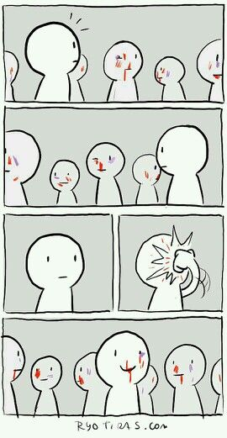
SO WHAT IS PEER PRESSURE?
It can be any influence that peers have on each other, to conform to behaviours and personal habits of a group
Most of the time, peer pressure is too subtle to identify, but has GINORMOUS effects

Slide 4
TYPES OF PEER PRESSURE
SPOKEN
UNSPOKEN
DIRECT
INDIRECT
NEGATIVE
POSITIVE
When one peer openly persuades another
When one peer is persuaded by exposure to behaviour
When one peer has to make an on spot decision
E.g., handing a cigarette over
When a peer overhears another gossiping, and changes behaviour due to indirect pressure
When a peer is pressured into behaviour that is against their moral code
When a peer is influenced by behaviour that is healthy, and responsible

Slide 5

SIGNS OF A TOXIC
ENVIRONMENT
Your friends make you feel bad about yourself
Your friendship is on their terms
You’re never sure where you stand
Gossip is constant, about friends
Effort is one sided
They don’t respect your boundaries
You feel pressure to do things you don’t want to
There is a competition to be ‘popular’
You’re terrified one mistake could make them leave you
They encourage your worst traits

Slide 6
HOW TO AVOID UNCOMFORTABLE SITUATIONS
Avoid going out with strangers
Make sure your parents/siblings are aware of your whereabouts
Take a phone with you
Respect other people’s boundaries
Draw boundaries
Be confident to say NO to anything you are not comfortable with
Dial the police number (100) if you feel a sense of danger

Slide 7
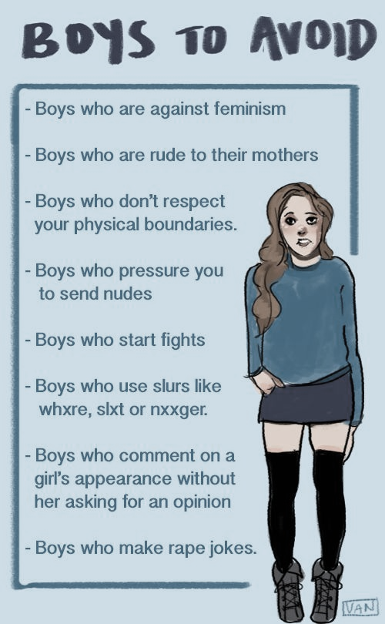
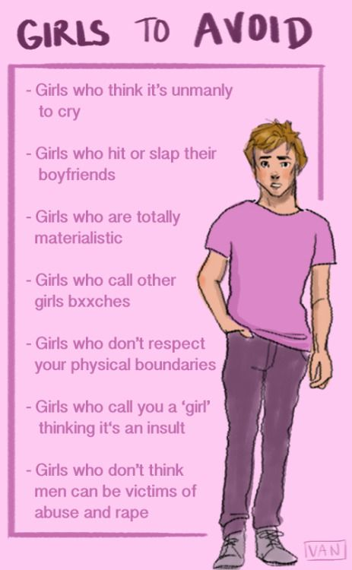
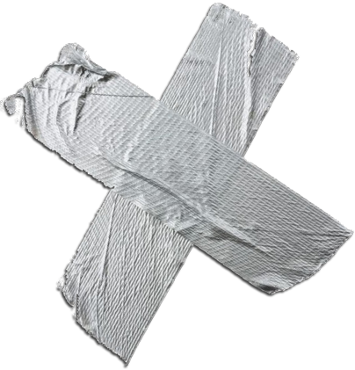
Learning to differentiate toxic people is the first step to cleansing toxicity!

Slide 8
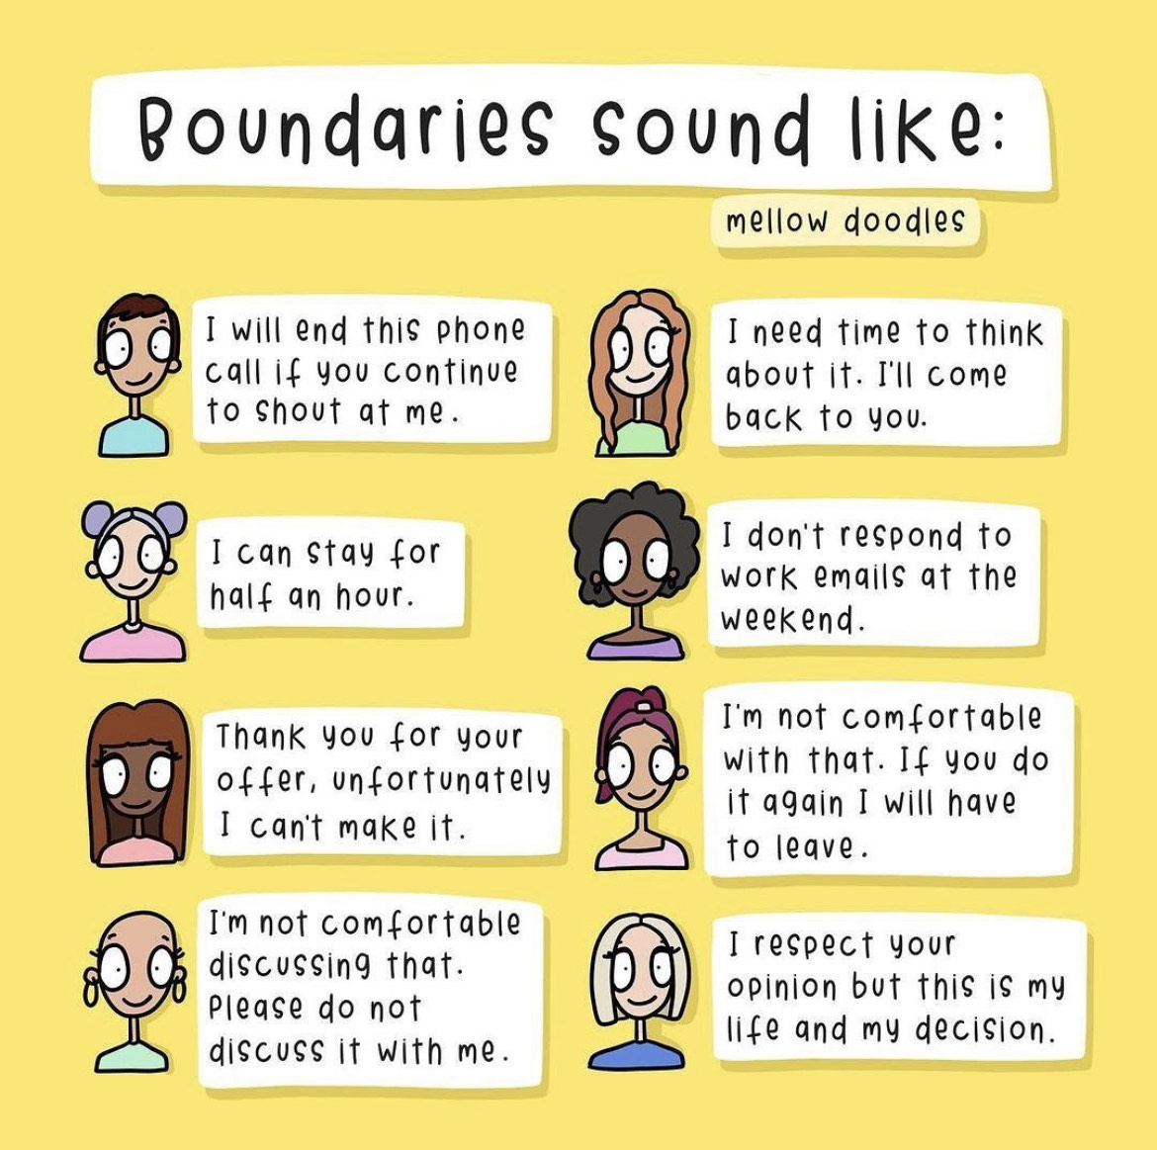
Learn to put yourself first!
Set boundaries you are comfortable with

Slide 9
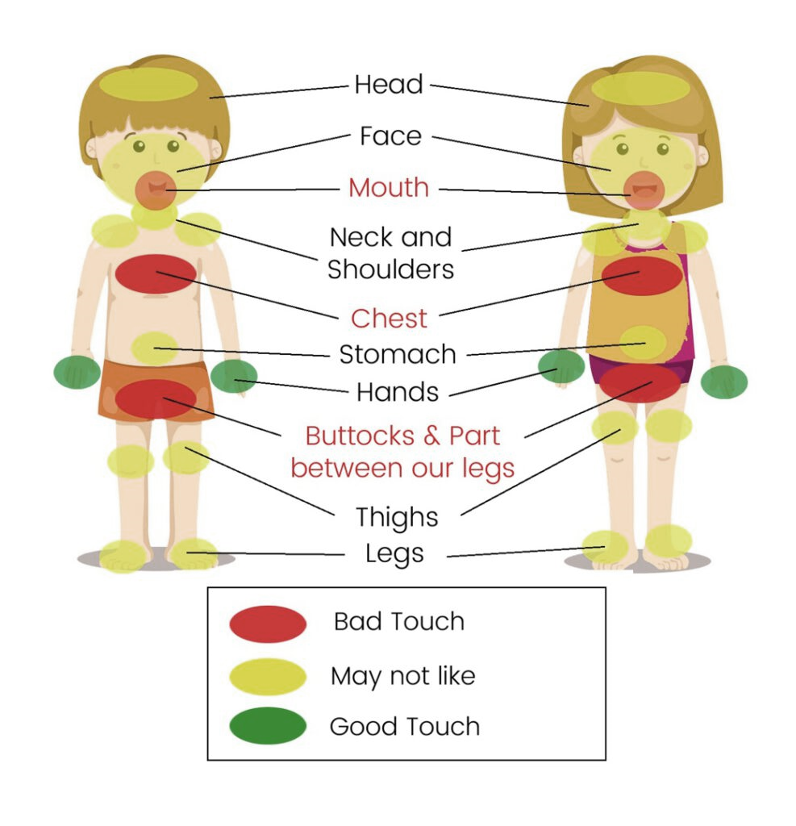
GOOD TOUCH
VS. BAD TOUCH
Peer pressure can make it feel like all touch is acceptable, which is not true!
Speak out whenever you feel uncomfortable
You have the power to say NO!

Slide 10

THE CONCEPT OF CONSENT
Consent is permission for doing anything
ALWAYS ask for consent
Do not assume consent
Respect consent
NEVER COERCE CONSENT

Slide 11
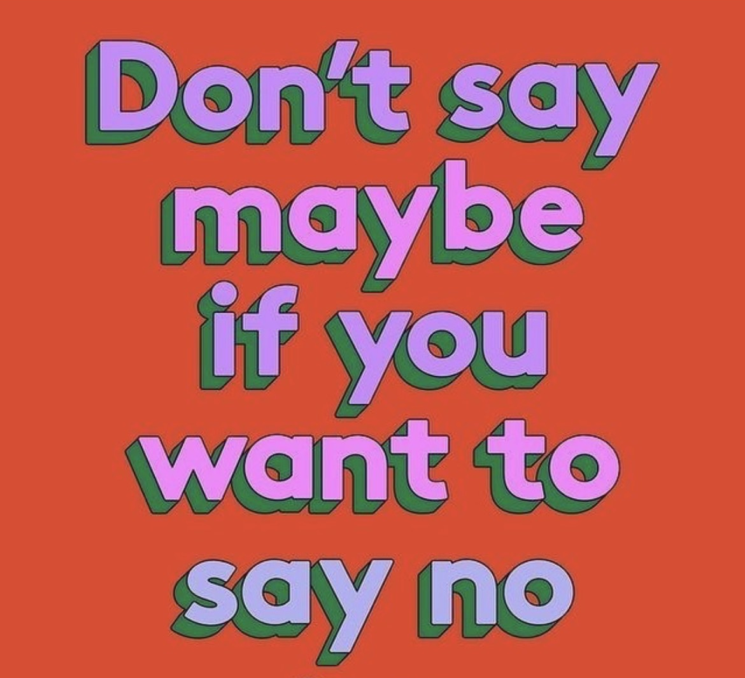
STAND UP TO PEER PRESSURE!
Just say NO, NOPE, or NAH
LEAVE the scene and say, ‘See you later?’
MAKE UP AN EXCUSE like ‘Yikes, I just remembered I have to (do something, talk to, be at such and such place)! Gotta run
USE HUMOUR like “If my parent’s found out, they would lock me in my room for like 30 years, and I’d be forced to eat baingen and brocolli”
CHANGE THE SUBJECT like “Oh hey! I almost forgot to tell you about……..”
SUGGEST A BETTER IDEA like “Let’s go check out…….. Instead?”
REMEMBER TO ALWAYS LISTEN TO YOUR GUT INSTINCT!!!

Slide 12

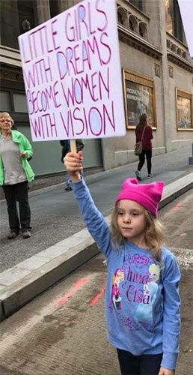
Dreaming of a better future for our future generations

Slide 13
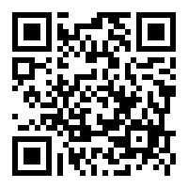
POST – TEST!
Type the link into your browser / scan the code:
https://bit.ly/3gzqypi
Make sure you finish the test within 3 minutes!
Certificate will be awarded to participants on course attendance and submission of Pre-Test, Post-Test, Feedback

Slide 14
- MALALA YOUSUFZAI
“I WANT EVERY GIRL TO KNOW THAT HER VOICE CAN CHANGE THE WORLD”

Slide 15
REGISTRATION
PRE – TEST!
POST-TEST
FEEDBACK
Certificate will be awarded to participants on course attendance and submission of Pre-Test, Post-Test, Feedback

Slide 16
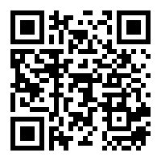
FEEDBACK!
Type the link into your browser / scan the code:
https://bit.ly/3iHuAyx
Make sure you finish the test within 3 minutes!
Certificate will be awarded to participants on course attendance and submission of Pre-Test, Post-Test, Feedback

Slide 17
A Sincere Thank You To All Those Who Helped Collaborate On This Project
Team DHEERA:
Dr. Shantha Kumari, Dr. Saroj Agarwal, Dr. Kiranmai Devineni, Ms. Shruthi Dulala, Ms. Gagana Erukulapati, Dr. Jamuna Devi Gudidevuni, Dr. Vaishali Korde, Dr. Krishna Kumari Meka,
Dr. Alka Mukherjee, Dr. Basab Mukherjee, Dr. Archana Singh, Dr. Pratibha Singh, Dr. Aruna Suman, Dr. Surekha Tayade, Dr. Rajal Thaker, Dr. Vindhya Tirumalreddy, Dr. Shobha Venkata Baireddy, Dr. Reena Wani, Mr. Ajey Bhardwaj
Contributors to Material on the Slides:
Dr. Saroj Agarwal, Dr. Kiranmai Devineni, Ms. Shruti Dulala, Ms. Gagana Erukulapati,
Dr. Jamuna Devi Gudidevuni, Dr. Krishna Kumari Meka, Dr. Alka Mukherjee, Dr. Archana Singh, Dr. Surekha Tayade, Dr. Rajal Thaker, Dr. Vindhya Tirumalreddy, Dr. Shobha Venkata Baireddy

Slide 18
Artists’ credits*
INTRODUCTION TO VAW:
Slide graphics
Slidesgo
Pictures
Slide 6: Jan Fischer
Slide 10: Stefania Infante
Slide 12: Aidyn Kahouch
Slide 14: BBC Future
Slide 15: https://elink.io/p/9673eba
Slide 16: https://feminisminindia.com/2017/05/24/alternative-menstruation-superheroes/
Slide 17: https://www.freepik.com/free-vector/gynecology-consultation-illustration_10100900.htm
TYPES OF VAW:
Slide graphics
PPTMON
Pictures
Slide 4: Laxmi by Bhubaneswarananda Halder
Slide 6: https://timesofindia.indiatimes.com/organisation-company/khap-panchayat/articleshow/56186940.cms
Slide 7: Ben Thomson
Slide 8: Benedetto Cristofani
Slide 9: Twitter/Annie E. Clark
Slide 11: https://www.shutterstock.com/image-vector/illustration-girl-wearing-apron-looking-down-1272005257
Slide 13: https://creator-en.pixtastock.com/@prof631888
Slide 17: Unknown source, print
Slide 18: https://www.slideshare.net/orangescape/posh-prevention-of-sexual-harassment-at-the-workplace
Slide 19: https://www.indiatoday.in/world/story/chinese-social-media-star-burnt-by-ex-husband-outrage-in-china-over-death-1727680-2020-10-02
Slide 20: Aleksandra Sabelskaia
Slide 22: UN Women Bosnia and Herzegovina
Slide 24: Sarah Crosby
Slide 25: https://www.coe.int/en/web/gender-matters/what-is-gender-based-violence
Slide 26: https://the-steppe.com/tags/nasilie-v-seme
MANAGEMENT OF VAW:
Slide graphics
Slidesgo
Pictures
Slide 5: Getty Images
Slide 6: UN Women
Slide 7: Unknown
Slide 8: medium.com/afrazaibunissa
Slide 9: www.techgropse.com/blog/women-safety-apps/
Slide 10: Courtesy of Women’s Funding Network
BYSTANDERS:
Slide graphics
Slidesgo
Pictures
https://www.freepik.com/free-vector/depressed-sad-woman-standing-as-victim-flat-vector-illustration_9649790.htm#page=1&query=victim
https://www.freepik.com/premium-vector/victim-cyber-bullying-illustration_10392359.htm#page=3&query=bullying&position=46
BRIDGING GENDER DIVIDE:
Slide graphics
Slidesgo
Pictures
Slide 6: Unknown
Slide 7: https://www.freepik.com/premium-vector/break-gender-norms-concept_8149546.htm
Slide 8: UN Women Moldova
Slide 9:UN Women
Slide 10: UN Women
Slide 11: Paige Jung
Slide 12: Instagram- @thatmentalhealthpage
Slide 13: Davide Bonazzi
Slide 14: Unknown
Slide 15: https://elink.io/p/9673eba
Slide 16: Unknown
Slide 17: UN Women
Slide 19: Creative Market
PEER PRESSURE:
Slide graphics
Slidesgo
Pictures
Slide 3: Ryo Tiras
Slide 5: lauramarcuet on DeviantArt
Slide 7: VAN
Slide 8: Mellow doodles
Slide 9: BrainKart
Slide 10: Unknown
Slide 11: Refinery29
Slide 12: Gillian Laub, Unknown
*All Graphics, pictures are used for representational, educational and not for profit purposes for the larger good of spreading awareness and sensitizing participants on the subject matter of VAW.

Slide 19
Courageous Together – Say No to Violence Against Women
#dheeratogether
Let’s Tweet Together!
Building A Voice – Our target is 100,000+ tweets, so ADD YOUR COURAGEOUS VOICE to the conversation!

