Slide 1


Bridging the gender divide
For DHEERA,
An initiative by Dr. Shanthakumari, President of The Federation of Obstetric and Gynaecological Societies of India

Slide 2

Whom do you identify with these names?
Shiva
Kashish
Nihar
Gunjan
Harsha
Nayan
Nirmal
Genders are nothing buy socially constructed concepts

Slide 3
Do these traits characterize males/females?
Male
Female
1. Active
2. Considerate
3. Aggressive
4. Creative
5. Ambitious
6. Competitive
7. Independent
8. Emotional
9. Leader
10. Artistic
11. Mechanical
12. Gentle

Slide 4
Conditioning of gender stereotypes
Stereotypes are so ingrained in our culture that they become a habitual response
Media and films reward violent male behaviour
Parents are more likely to use physical punishment with sons that win daughters
Parents are more likely to tolerate violent behaviour in boys than in girls
When girls show aggressive opinions or leadership, they are known as bossy, rather than responsible
Stereotypical rules restrict personal choice, foster sexism and create unequal outcomes

Slide 5

Is gender a social evil?
In Indian society, women are oppressed officially and unofficially
Discrimination starts young, when girls are expected to do household chores, behave submissively
Emphasised when women are expected to leave work to raise kids
Male babies are preferred over female babies
Workplace discrimination at work causes pregnant women to be fired, and a massive wage gap between men and women
No woman is safe from sexual harassment, such as eve-teasing and cat-calling
Women are called goddesses, but even the tiniest of mistakes on their behalf makes them unworthy of being respected
Women do not want to be treated like goddesses. Women want to be treated like humans.

Slide 6
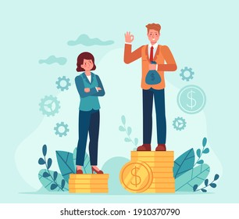
It is not a level playing field!
Some countries still don’t give women voting rights
Women still don’t have equal access to education
Child marriages and dowry are prevalent
Women are not given opportunities at work
One man’ voice is worth more than that of many women
Women have less access to financial resources
There is not enough representation for women in many fields, including politics and leadership

Slide 7
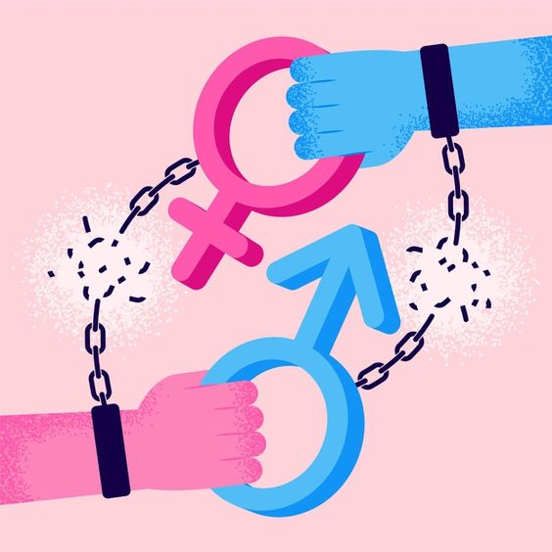
All the genders have to work together as allies…
... To create a
Gender Neutral, gender responsive and equal society
… To eliminate
Gender inequality and gender bias
Gender based prejudice is not an issue of one gender!

Slide 8
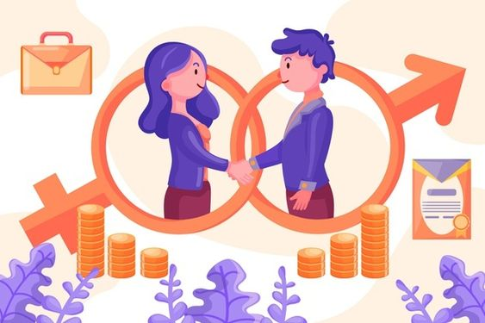
Boys! It’s not enough to not commit violence!
You must be willing
to take 8 Active Steps to ensure the no other men commit such violence

Slide 9
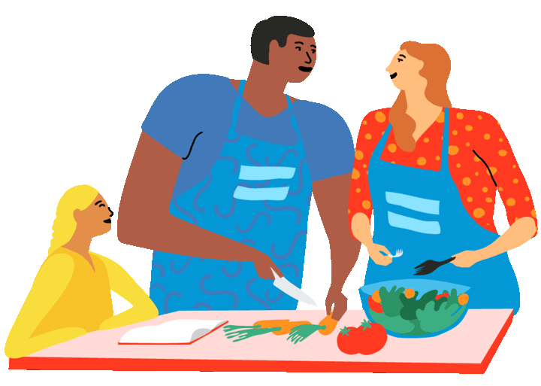
1. Share the Care
Women take on 3x more unpaid care and domestic work than men
Women spend energy and emotional labour at home, with family, instead of advancing career or looking after themselves
Appreciate those who help you unconditionally
Respect the sacrifices being made for you
Offer to help whenever you can
Encourage women to take up their own interests

Slide 10
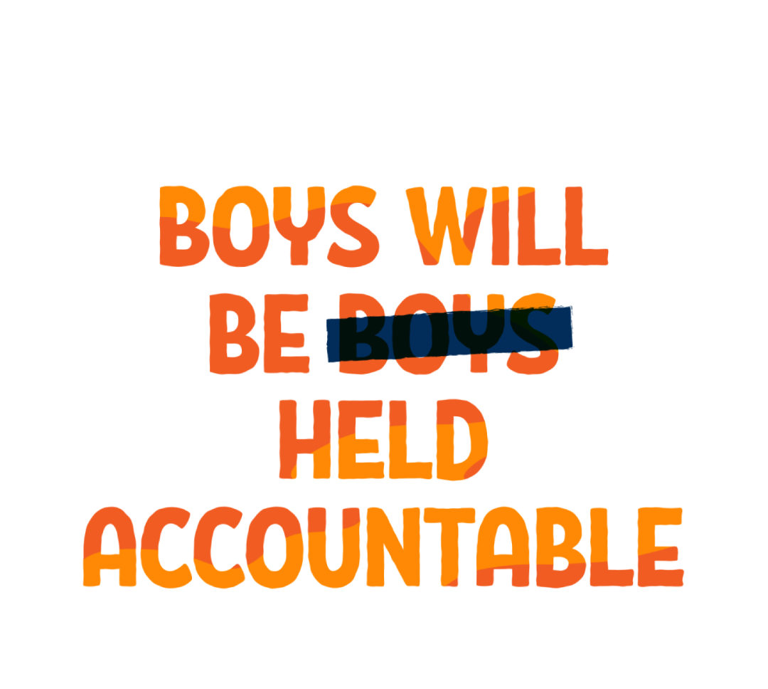
2. Hold yourself accountable
Respect men and women equally
Be aware of your own behaviour
Make sure you’re open to criticism
Change yourself when you see toxicity

Slide 11
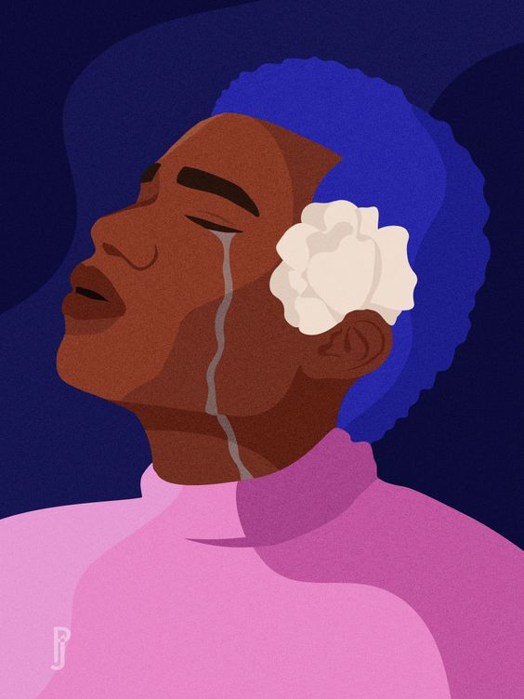
3. Change notions of traditional masculinity
Example: “Man Up”, “Don’t Cry”, “Be Strong”
Treat everyone the same way, regardless of gender
Allow yourself the freedom to break norms and challenge stereotypes
Question those that do not allow you to challenge stereotypes
Do not excuse men just because they are men
Make the sensible male fashionable, not the alpha male!

Slide 12
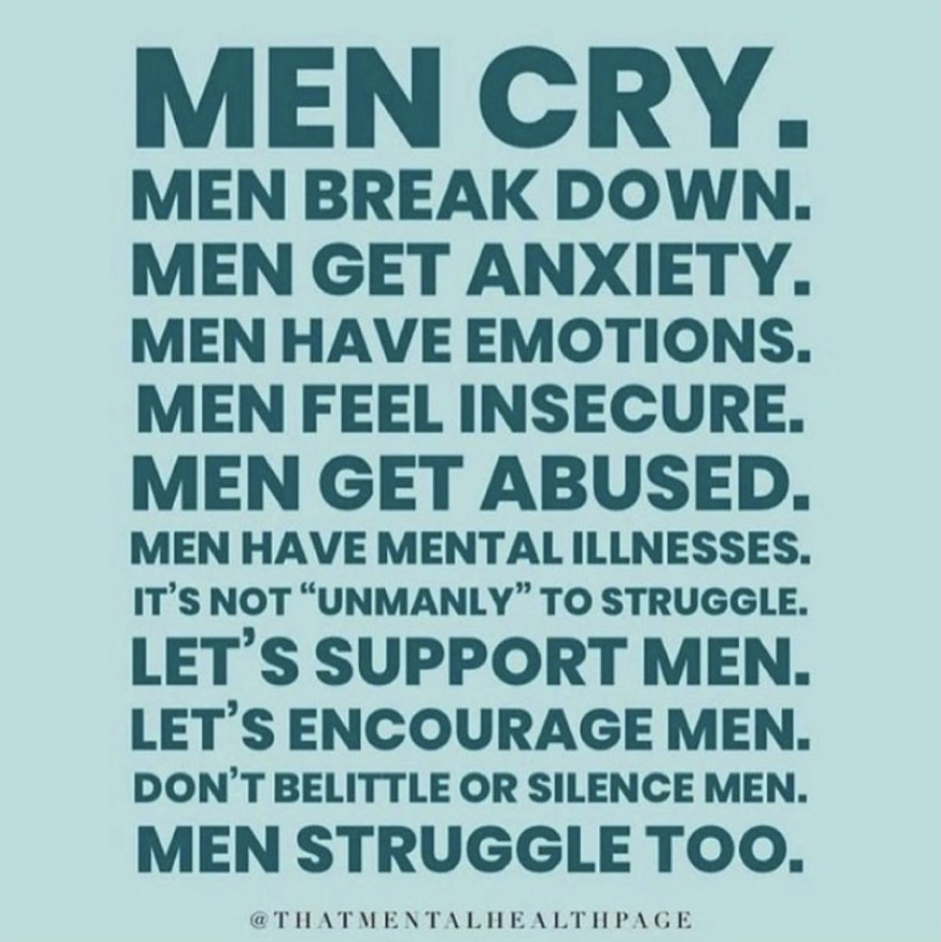
Sensitive men will change the next generation!

Slide 13
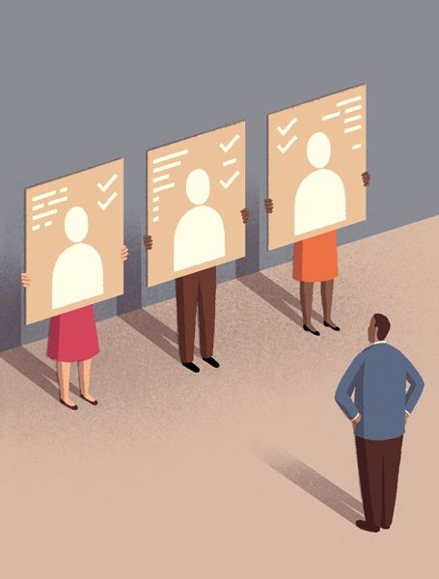
4. Respect others’ choices
When someone’s make you uncomfortable, ask yourself why
Examine your biases
Consider the circumstances that make your life different from yours
Do not judge/shame them for their choices

Slide 14

5. Understand consent
Are phrases such as “Hasee toh Phasee” true?
Clear consent is the word “Yes”. Nothing else.
“She was asking for it”? Why couldn’t you?
“Boys will be Boys” is never acceptable
Never victim blame

Slide 15
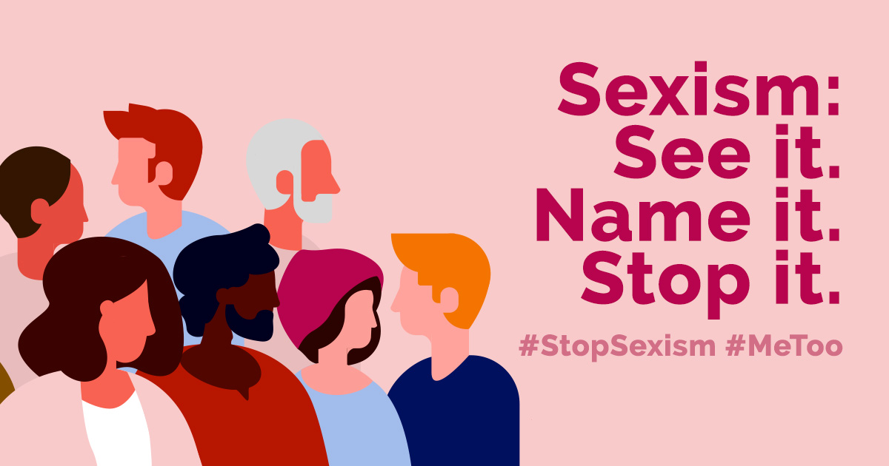
6. Call out sexism and harassment!
All women experience sexual harassment at least once in their lifetimes
All women experience sexism once a week
Call out such behaviour in a safe, respectful manner
Be an active bystander!
Do not excuse friends, relatives or coworkers

Slide 16
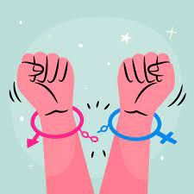
7. Challenge Gender Stereotyping!
Question your own stereotyping and prejudices
Challenge any stereotypical notions of gender like “Women are not good at driving”
Counter the argument with facts

Slide 17
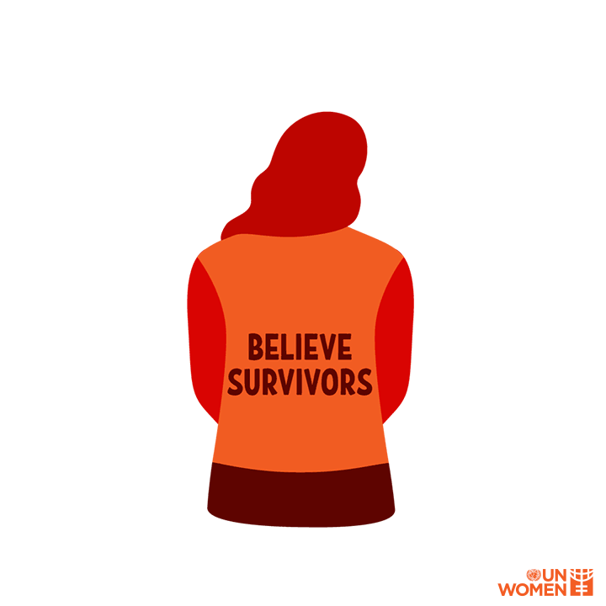
8. Believe survivors
Every time a woman speaks up about her experiences, and she is not believed, toxic culture flourishes
When you here a survivor’s story:
1. Listen
2. Believe
3. Support
Be an ally and offer unconditional support!

Slide 18
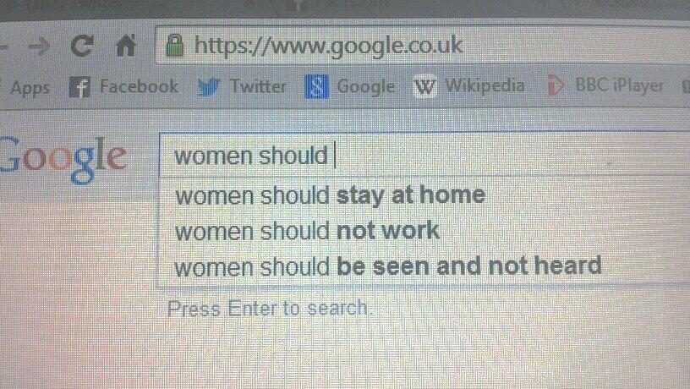
Change the Dialogue!
Top google searches, show these
How can you change the narrative?
Make a gender-neutral society

Slide 19
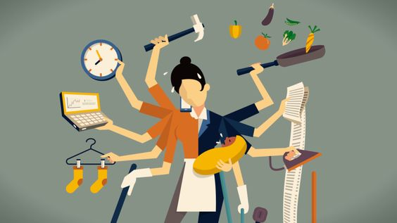
We can do anything, be anything.

Slide 20
Courageous Together – Say No to Violence Against Women
#dheeratogether
Let’s Tweet Together!
Building A Voice – Our target is 100,000+ tweets, so ADD YOUR COURAGEOUS VOICE to the conversation!

Slide 21
REGISTRATION
PRE – TEST!
POST-TEST
FEEDBACK
Certificate will be awarded to participants on course attendance and submission of Pre-Test, Post-Test, Feedback

