Slide 1



ROLE OF ACTIVE BYSTANDERS

Slide 2
An individual who observes an act of violence, discrimination or other problematic behaviour, but are not its direct perpetrator
Who is a bystander?

Slide 3
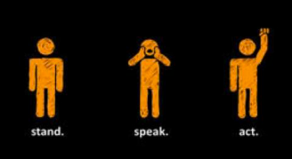
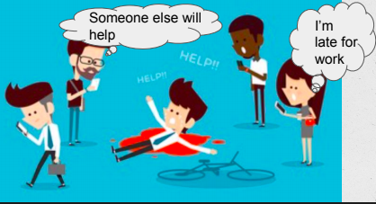
Types of Bystanders
Active
Passive
Who take action and try to stop it.
Who do not act or intervene.
Due to:-
Social influence
Audience inhibition
Fear of retaliation

Slide 4
5D’s
The weapons of active bystanders

Slide 5
01
DISTRACT
It’s a subtle and safe way to intervene. The aim is to interrupt and derail the incident
Pretend to be lost
Ask for time or address of a place
Pretend you know the person being harassed
Talk something irrelevant and take the attention off the harasser

Slide 6
02
DELAY
Delaying can reduce the severity
Ask the victim if she’s okay
Offer to accompany her to her destination or sit with her for awhile

Slide 7
03
DELEGATE
Delegation is when you ask for assistance for a resource or for help from a third party
If near a shop ask the shopkeeper
If on a bus ask a co-passenger bus conductor to intervene
If you’re in school contact teacher for help

Slide 8
04
DOCUMENT
First assess the situation
Is anyone helping the person being harassed ?
If not, use one of the other D’s. If someone else is already helping out , assess your own safety
Only if you are safe then only go ahead and start recording
ALWAYS ask the person who was harassed what they want to do with the recording

Slide 9
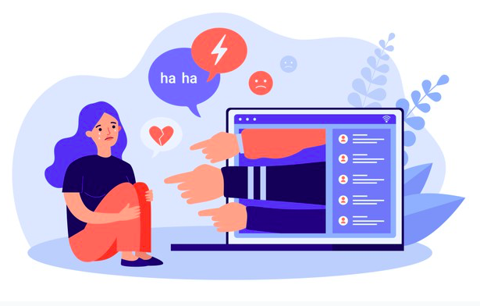
NEVER POST IT ONLINE
Using an image or footage of a person being victimized without the person’s consent may make the person feel even more depressed and can lead to a level of visibility that person may not want.
Publicizing another person’s traumatic experience is no way to to an effective bystander.

Slide 10
05
DIRECT
Directly respond to harassment by naming what is happening or confronting the harasser
This can be risky the harasser may redirect their abuse towards you
It may escalate the situation
Be clear, confident, but cautious

Slide 11
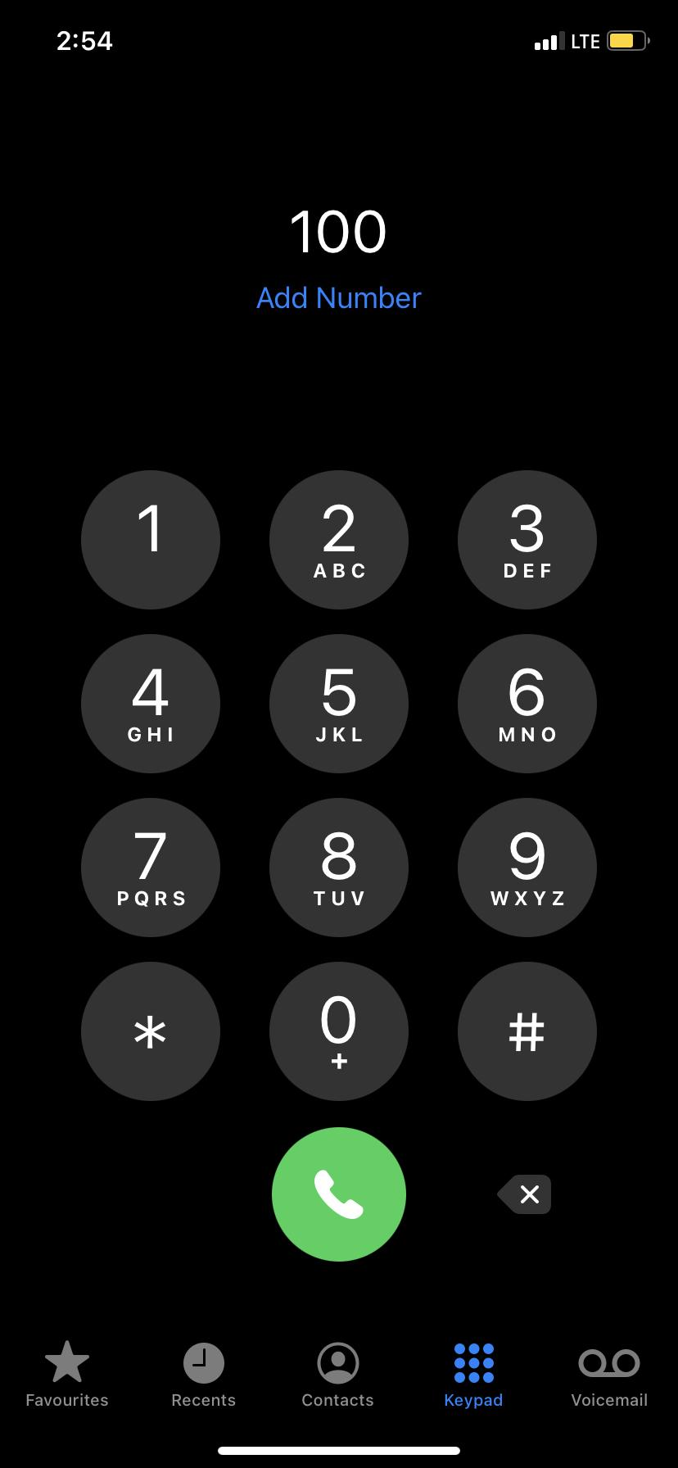
Golden Rule
DIAL
100
1098
or
Only intervene, if it’s safe for you to do so.
If not safe, call the police.
Or the Child Helpline no. 1098

Slide 12



MORE WAYS TO GET INVOLVED
Organise actions like writing stories, posters and nukkad natak
Appreciate someone practising bystander intervention
If you know some organisation is working for it, donate your time and ideas

Slide 13
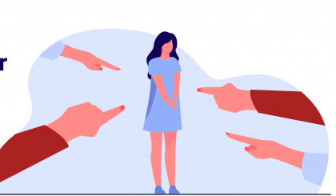
THE WRONG THINGS TO SAY
Why did she go at night
Why did she park her scooter there
Why did she go alone
Why did she call her sister instead of 100
VICTIM BLAMING SHOULD NEVER BE DONE. NEVER!

Slide 14
Courageous Together – Say No to Violence Against Women
#dheeratogether
Let’s Tweet Together!
Building A Voice – Our target is 100,000+ tweets, so ADD YOUR COURAGEOUS VOICE to the conversation!

