Slide 1



Types of VAW
For DHEERA,
An initiative by Dr. Shanthakumari, President of The Federation of Obstetric
and Gynaecological Societies of India

Slide 2
Contents
01
02
03
Physical Violence
Psychological Violence
Combination
Acid Attacks
Honour Killings
Femicide
Sexual Violence
Financial Manipulation
Emotional Abuse
Bullying
Stalking
Eve Teasing
Criminal Intimidation
Domestic Violence

Slide 3
Physical
Violence

Slide 4
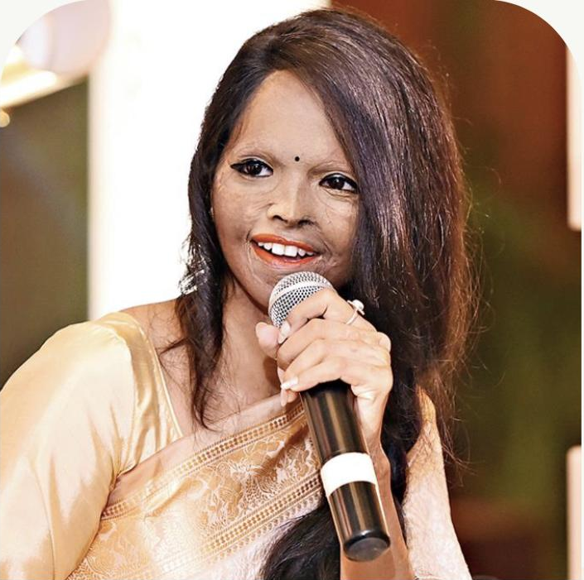
Acid Attacks
*
A form of assault, involving throwing a corrosive substance onto another
Sometimes used as a form of blackmail
Case Study: Ms.Laxmi Agarwal
Laxmi was attacked in 2005, at the age of 15, after rejecting the romantic advances of a man who was 32 years old
For more details: You may watch the movie ‘Chhapaak’
*
Photo of Ms.Laxmi Agarwal is used for representation and educational purposes only. This is in solidarity for all those who are fighting for the cause of Violence Against Women.

Slide 5
What can you do?
If attack is threatened or attempted
If attacked, report attack to doctor
Report attack to adult
Report attack
to authorities
Report to trusted adult and police
Make sure to stay away from person threatening
Always travel with others
Under Section 326B IPC, imprisonment not less than 5 years but which may extend to 7 years, and shall also be liable to fine
Make sure to get treatment as soon as possible
Talk to parents, teachers, police, or anyone you trust
Make sure you stay away from perpetrator of crime
Section 326A IPC can be charged
Leads to imprisonment not less than 10 years, which may extend to imprisonment for life
Fine charged to meet the medical expenses of victim

Slide 6
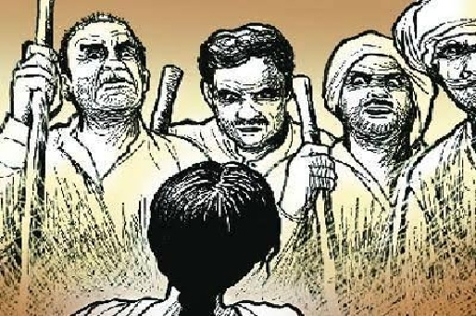
Honour Killing
Murder of an individual, either an outsider or a member of a family
Used to ‘protect’ reputation of the family, as it is believed that the victim brought disrepute to the family

Slide 7
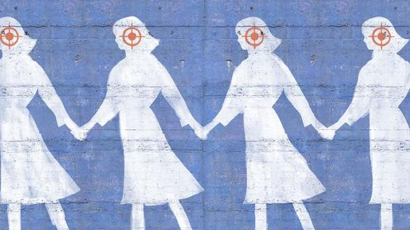
Femicide
A gender based crime
Arises when society prefers males over females
Can take the forms of:
  Women based hate crime
  Infanticide : Killing of a newborn female child
  Foeticide: Abortion of foetuses based on gender

Slide 8
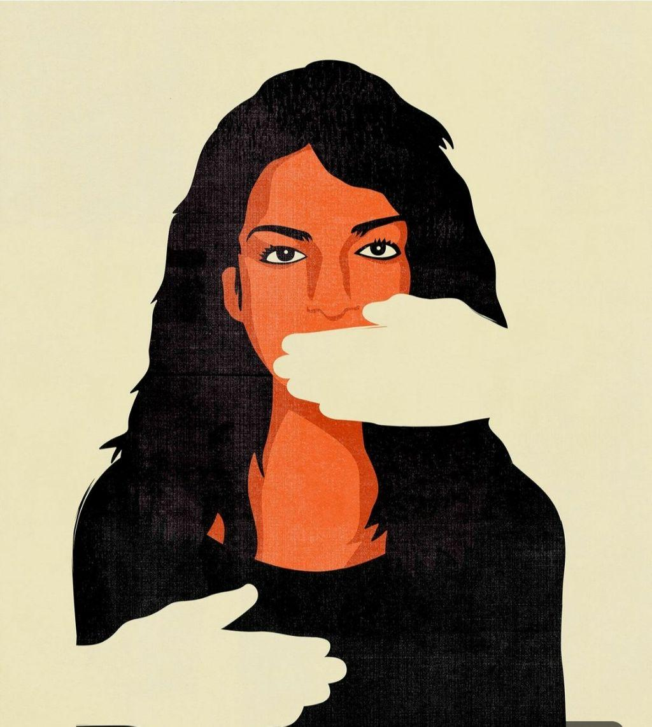
Sexual Assault
An act in which a man sexually touches a woman or compels her to get naked, forcefully, and without outward consent
Punishable under Section 354 IPC, with 1-5 years and a fine
Causes long term mental trauma to the victim
If you see sexual assault taking place, stop it, or call help, even if your friend is the abuser
Nirbhaya Act, 2013, and Section 375 IPC, protect women against any type of rape
Section 354 A IPC, protects against sexual harassment, and unwanted physical contact
POSCO Act, 2012 protects minors from sexual abuse

Slide 9
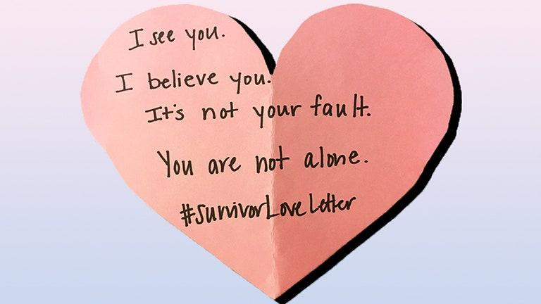
If you are a survivor,
Do not shame yourself. You are not to blame
Don’t take a bath/wash yourself
Don’t change your clothes
Write down what happened
Inform the police
Report in a timely manner, so that there is evidence
Don’t be afraid to speak up, as you are never at fault, and an abuser is bound to repeat actions

Slide 10
Psychological Violence

Slide 11

Financial Manipulation
Involves making or attempting to make a person financially dependent by maintaining total control over resources, withholding access to money, and/or forbidding attendance at school or employment
Case Study
Raj monitors his wife, Ananya’s bank account, and doesn’t let her buy what she wants. Raj’s parents don’t let Ananya go to work.
What can Ananya do?

Slide 12

Emotional Abuse
Undermining a person’s sense of self worth through constant criticism
Most common examples:
  Name-calling
  Damaging a partner’s relationship with children
  Not letting partner see friends or family
disputing your feelings
making you feel guilty
overreacting for small things
threatening to hurt themselves
nothing you do or say is good enough
controlling you: telling you how to dress
Signs of
Emotional Abuse
Case study
Shreya is married to Ashok, whose colleagues mock him for earning less. Feeling hurt over his pride, Ashok takes out his frustration by drinking more often, frequent rage behaviour, tantrums by breaking things, yelling and blackmailing Shreya of divorcing her. This constant fault finding behaviour of Ashok had a toll on mental health of Shreya.
What can Shreya do?
humiliating or embarrassing you
Blaming you for things going wrong in their life
feeling jealous when you’re close to someone else

Slide 13
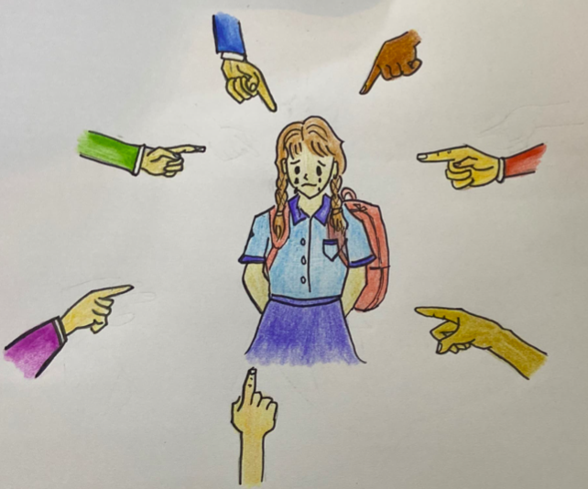
Bullying
Continuous harassment, either verbal or physical
Can be in the form of cyber bullying, or ragging
Case Study
Neel, a senior asks out Ria, his junior, who rejects him. He feels embarrassed and to bandage his pride, starts up a rumour that Ria is a ‘slut’. He starts to harass her everyday, calling her fat, ugly and other such derogatory terms. He throws eggs at her house, with his friends; pours water on her homework, and provokes all his friends into teasing her whenever they see her.
You see this taking place, what do you do? Do you help Ria? Who do you contact?

Slide 14

Cyberbullying
EXCLUSION
An act of deliberately excluding someone from an online group
Online form of bullying and abuse
When technology is used to write aggressive, embarrassing or hateful messages to/about peers in order to intimidate, harass, shame and control
Includes
  Threatening/abusive text messages, creation of embarrassing images or videos
  Sharing them, creating fake accounts, stealing online identities
  Sharing sexually explicit messages
GOSSIP
Damaging a person’s reputation and/or relationship with family or friends.
FRAPPING
Impersonating a person by logging into someone else’s social networking account
HARASSMENT
Constant and intentional posting/sending offensive, threatening messages
OUTING & TRICKERY
Act of tricking someone into revealing personal information which is then shared publicly to humiliate him/her
CYBERSTALKING
Did you know?
FAKE PROFILES
fake profiles are created hide their real identity
Females are 2x more likely to be victims of cyberbullying

Slide 15
What can you do if you’re being cyber-bullied?
Check platform’s anti-bullying policy
Blocking and Reporting
File a criminal complaint
Get in contact with customer service representatives if confused
Make sure to collect screenshots
Approach the cyber investigation cell
You can report to a cyber cell from any city,
If unable to report to cyber cell, lodge FIR, or reach women oriented ‘she-teams’

Slide 16
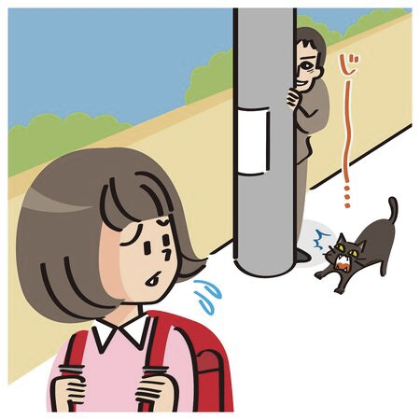
Stalking
When an individual follows a woman, and repeatedly tries to contact her without consent
Can occur digitally
Section 354D IPC imprisons the culprit for 1-3 years, and culprit can be liable to fine
Case Study
Sanjay, 17, starts to follow around Meera, 17, everywhere she goes, learning her everyday routine, taking pictures of her, joining her tuitions, etc. His friends start to encourage him, comparing him to popular roles that actors have played in Bollywood movies.
Meera starts to feel uncomfortable, what can she do next?

Slide 17
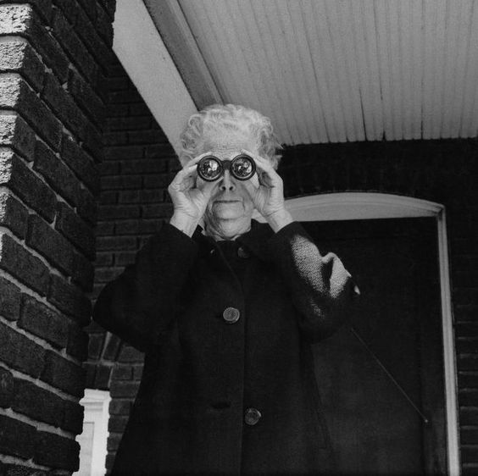
Voyeurism
The watching or/and taking pictures of women, without consent, and without the knowledge of the woman
Section 354C IPC, imprisons the culprit for 1-3 years on first conviction
After more convictions, abuser can be imprisoned for 3-7 years

Slide 18
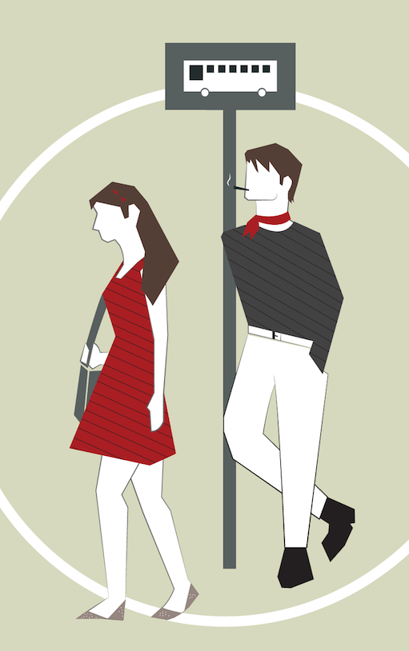
Eve - teasing
Obscene actions like unwanted remarks, sexual advances by a man, to insult a woman, in a public place, is eve-teasing
Section 294 IPC punishes men who act/speak in an obscene way, for a maximum of 3 months
Section 509 IPC punishes men who acts or uses an object to insult a woman with hail term for up to 3 years

Slide 19

Criminal Intimidation
When someone is threatening to cause death, hurt grievously, or to destroy your property
Section 503 IPC can cause imprisonment for up to 2 years, or a fine, or both

Slide 20
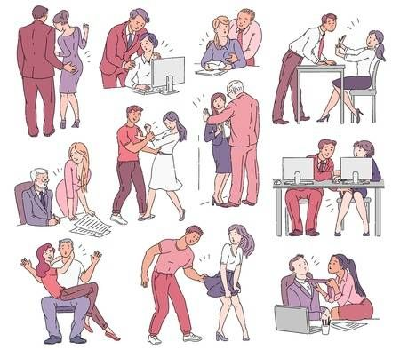
Sexual Harassment
Unwelcome sexual advances, requests for sexual favours, sexual remarks, showing pornography without consent, all constitute as sexual harassment
Can be reported under Section 354A IPC, which is punishable with up to 3 years of imprisonment
Case Study
Unseasonal rain has caused a farmer to lose a considerable amount of crop that he was unable to sell. To make ends meet, he takes a loan from the village loanshark, Raghu. After a few months, unable to pay his loan back, his daughter offers to help settle her father’s debt by working for the loan shark. Taking advantage of their desperation, Raghu sexually harasses the girl.
If you saw this happening, what could you do?

Slide 21
Combination

Slide 22
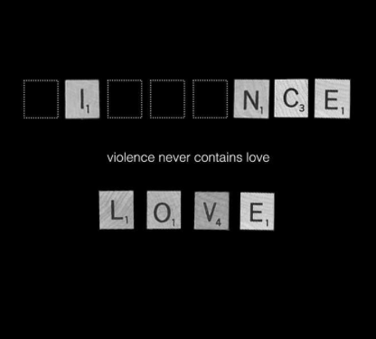
Domestic Violence
Doesn’t just have to between a married couple
Any pattern of behaviour used to gain/maintain power or control over partner
Main Issues
Most victims of domestic violence do not know that they are being abused
It is hard to believe a trusted partner could be manipulative
Can also be harassment from in-laws

Slide 23


Using Coercion
& Threats
Using
Intimidation
Using Emotional
Abuse
Using Economic
Abuse
Examples
POWER
&
CONTROL
Using Male
Privilege
Using Isolation
Minimising,
Denying
&
Blaming
Using
Children

Slide 24
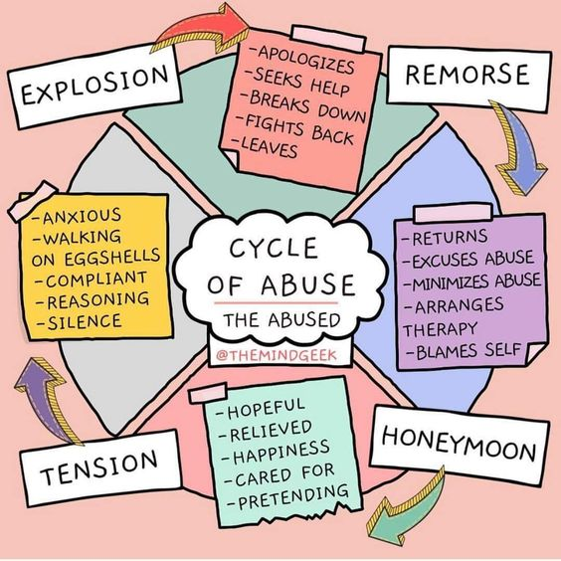
Cycle of Abuse

Slide 25







Domestic Violence Act, 2005
Covers physical, sexual, verbal and economic abuse
Grants immediate protection
Punishes the abuser with imprisonment upto 3 years

Slide 26

Ending VAW, one step at a time

Slide 27
Courageous Together – Say No to Violence Against Women
#dheeratogether
Lets Tweet Together !
Building A Voice – Our target is 100,000+ tweets, so ADD YOUR COURAGEOUS VOICE to the conversation!

