Slide 1



What is Violence against Women?
How does DHEERA play into it?
For DHEERA,
An initiative by Dr. Shanthakumari, President of The Federation of Obstetric and Gynaecological Societies of India

Slide 2
Agenda
03
04
01
What is DHEERA?
What is VAW?
Management
of VAW:
Introduction
Role of Bystanders
Bridging the gender gap
02
Types of VAW
What is such behaviour called?

Slide 3

PRE – TEST!
Type the link into your browser / scan the code:
https://bit.ly/2SwSLVM
Make sure you finish the test within 3 minutes!
Certificate will be awarded to participants on course attendance and submission of Pre-Test, Post-Test, Feedback

Slide 4
What is DHEERA?
DHEERA means “courageous”
The power of being Together
#dheeratogether

Slide 5
— Fuad Alakbarov
“Not all men practice violence against women but all women live with the threat of male violence every single day. All over the Earth.”

Slide 6
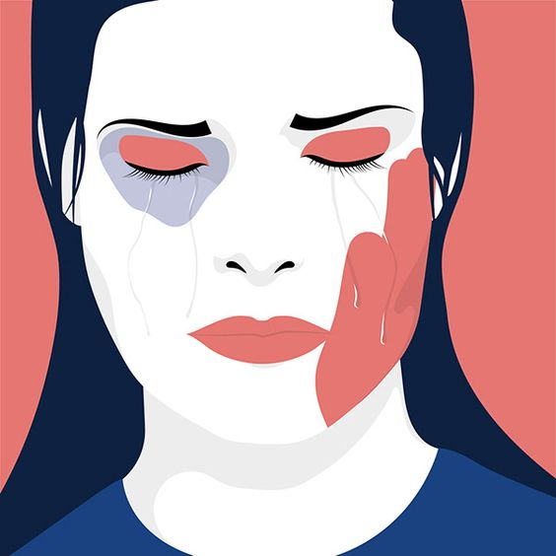
Violence against Women
A global human right’s violation
Short-term and long-term physical, economic and psychological consequences
Prevents their full and equal participation in society
The magnitude of its impact on society is immeasurable
Conditions created by the pandemic, ex. including lockdowns, reduced mobility, heightened isolation, stress and economic uncertainty – have led to an alarming spike in domestic violence

Slide 7
01
Are you aware of/ have you seen any woman being beaten, threatened, scolded at home, school, neighbourhood?
02
03
Do you think this is right?
What is such behaviour called?
Is there any word to describe it?

Slide 8
Violence against Women
It’s called

Slide 9
Violence against Women is the most shameful human rights violation.
It is most widespread
It knows no boundaries of geography, culture or wealth
As long as it continues, there is no real progress towards equality, development and peace

Slide 10
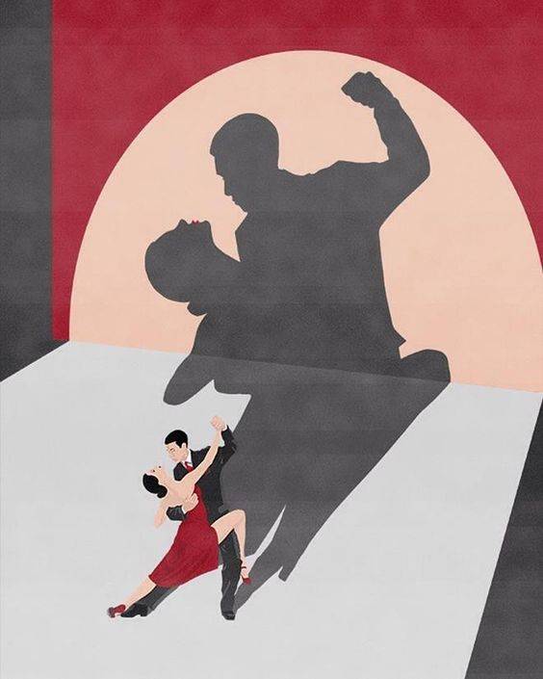
What exactly is VAW?
Mental
Forcing a woman to live in fear
Sexual
Physical

Slide 11
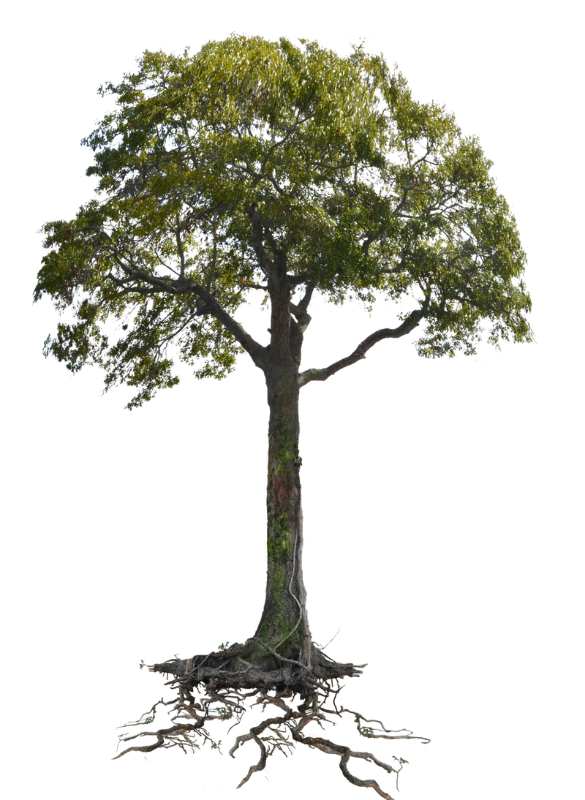
The Roots of VAW
Toxic Masculinity
Patriarchal Society
Gender Bias
Gender Stereotyping
Sexism

Slide 12

Gender Bias
Preference for males
Girls considered burdens
Foeticide and infanticide
Neglecting female health issues

Slide 13
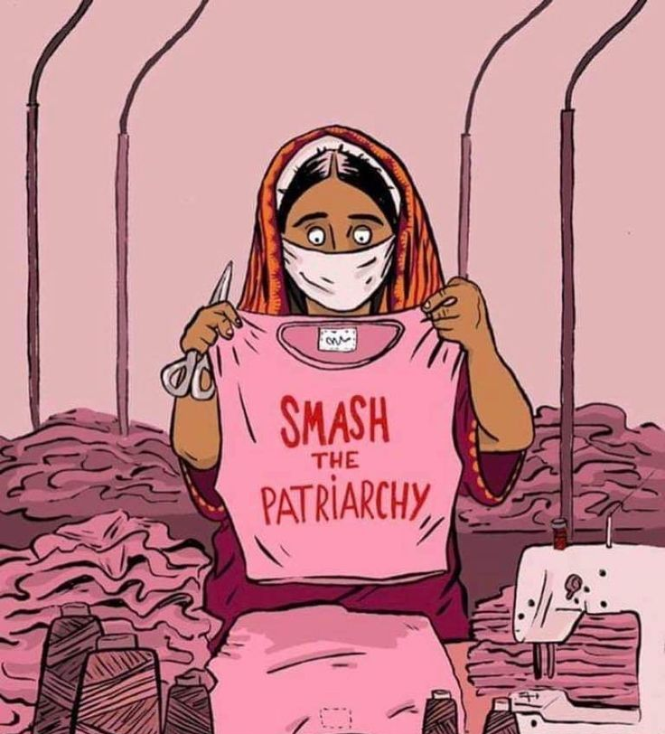
Patriarchy
A system of society or government in which men hold the power and women are largely excluded from it
Decision making rests with the male in the family

Slide 14
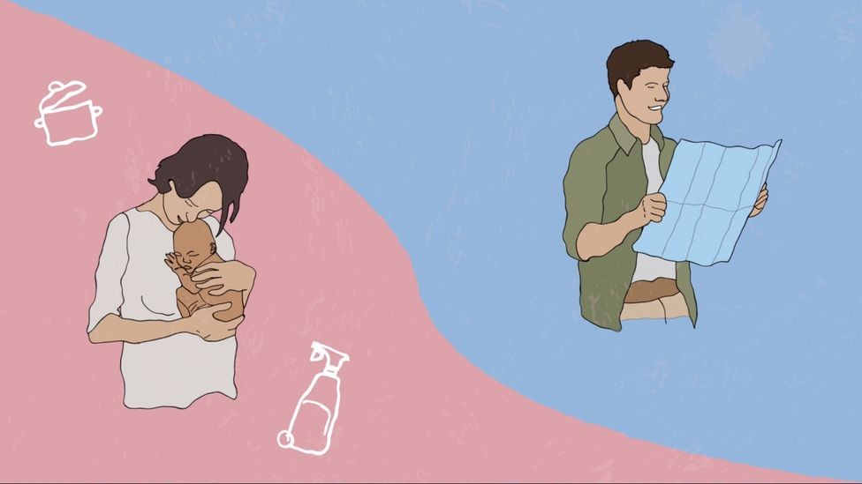
Gender Stereotyping
Girls | Boys
Faithful | Competitive
Emotional | Logical
Tolerant | Strategic
Sympathetic | Aggressive
Dependent | Independent

Slide 15
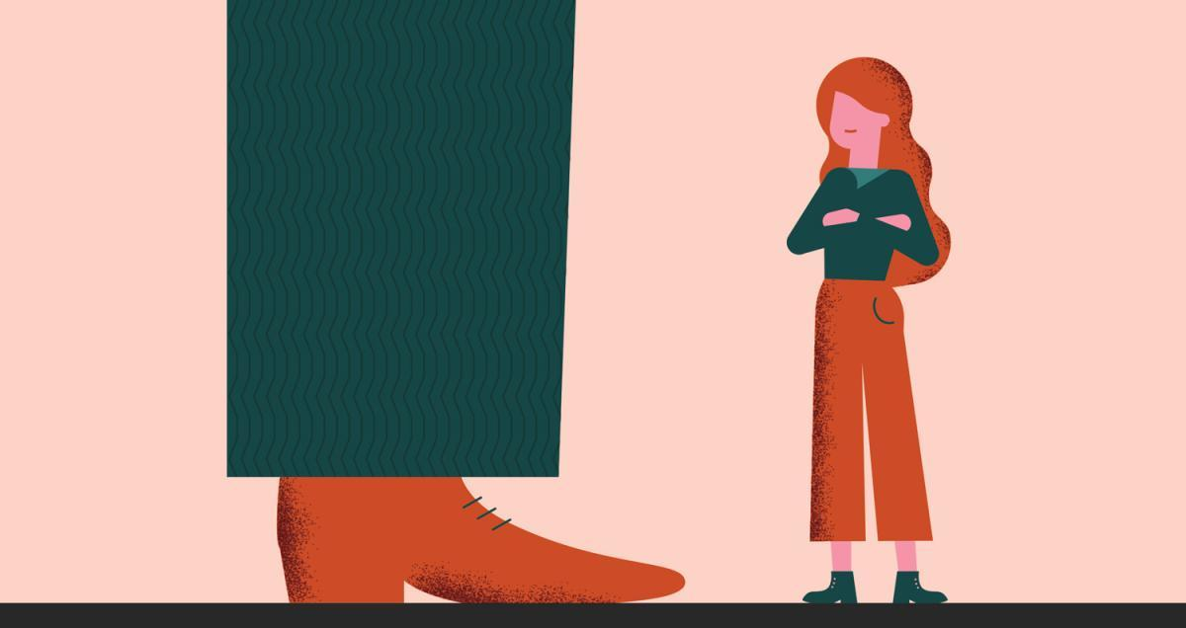
Sexism
Prejudice
Stereotyping
Discrimination, typically against women, based on sex/gender
Can you think of any examples of sexism?

Slide 16
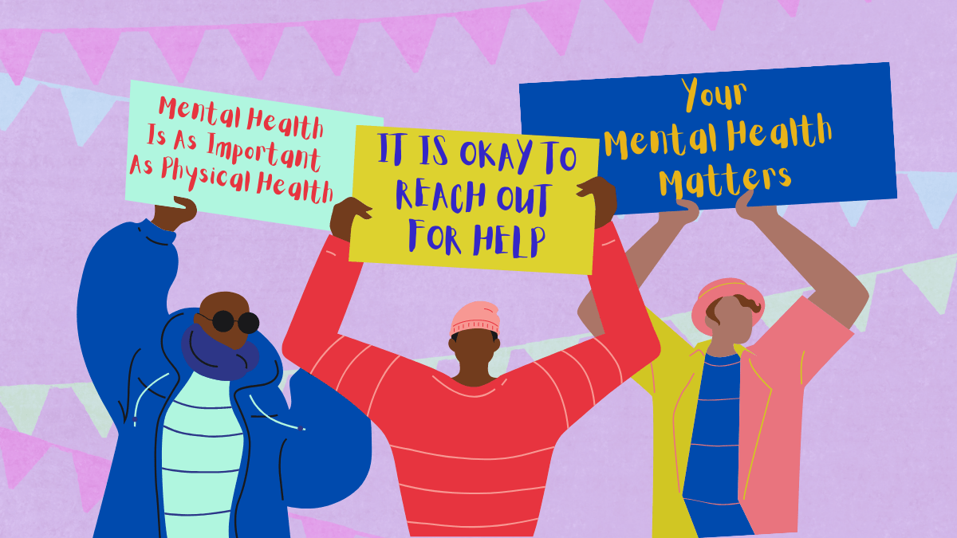
Toxic Masculinity
“I Am A Man”
“I Am Strong”
“I Don’t Cry”
“I Can Control”
“I Am The Boss”
“I Am The Savior”

Slide 17
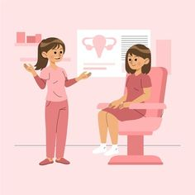
Why doctors for women want to talk about VAW?
01
02
03
Gynecologists are points of contact who can recognize changes in lifestyle
Most of the health problems of women are rooted in violence
Serious health problems during pregnancy have roots in violence

Slide 18
Why DHEERA?

Slide 19
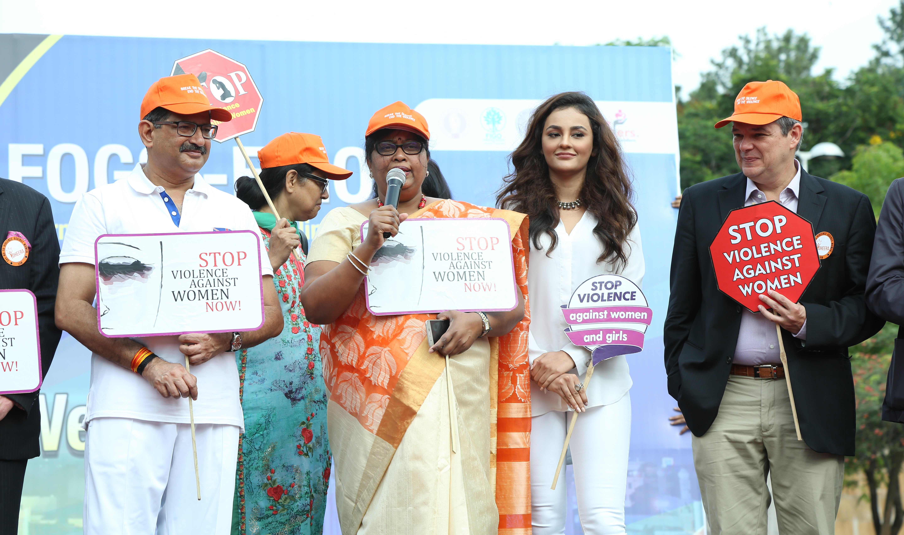
The Campaign
Founded by FOGSI President, Dr. Shanthakumari, to stop violence against women

Slide 20
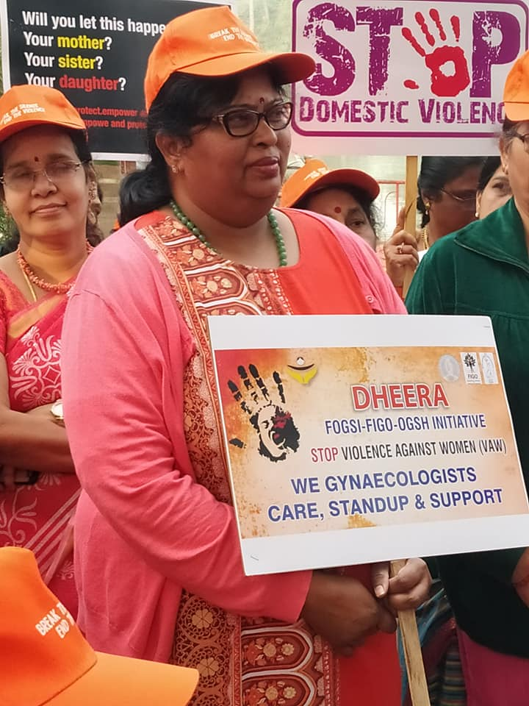
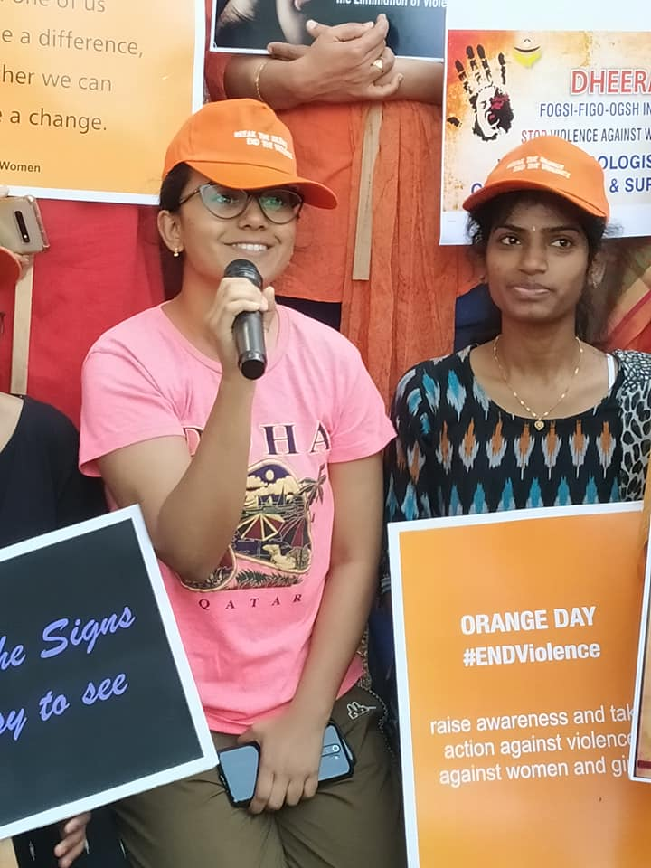
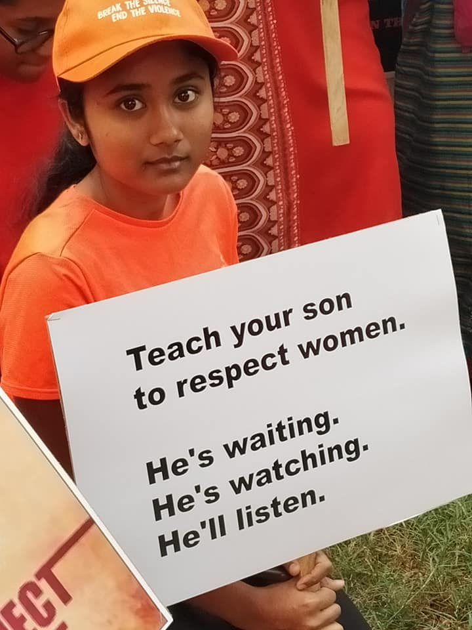
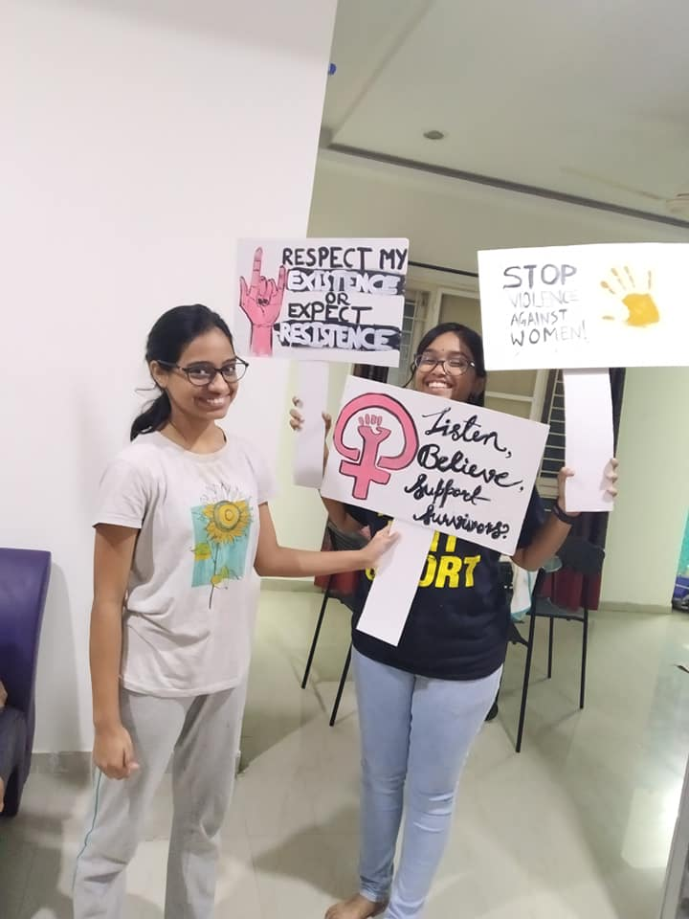

Slide 21
Courageous Together – Say No to Violence Against Women
#dheeratogether
Let’s Tweet Together!
Building A Voice – Our target is 100,000+ tweets, so ADD YOUR COURAGEOUS VOICE to the conversation!

