Slide 1
What is DHEERA?
DHEERA means “courageous”
Dheera – flagship program of FOGSI Imm. Past President
Dr S Shanthakumari
Power of being DHEERA Together
#dheeratogether

Slide 2
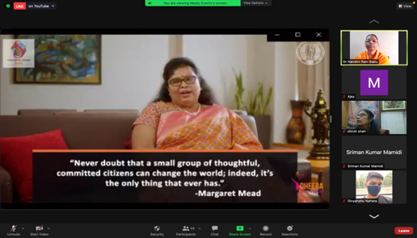
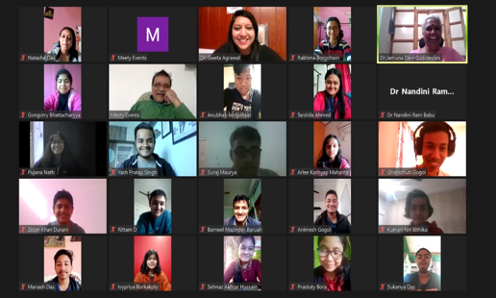
Achievements
Dheera Sessions Completed
3196
Students Trained
228899
Teachers Trained
7000
OBGYN Oriented
42000+
Master Trainers Trained
1564

Slide 3

Achievements
Article published in IJGO
https://doi.org/10.1002/ijgo.15120

Slide 4
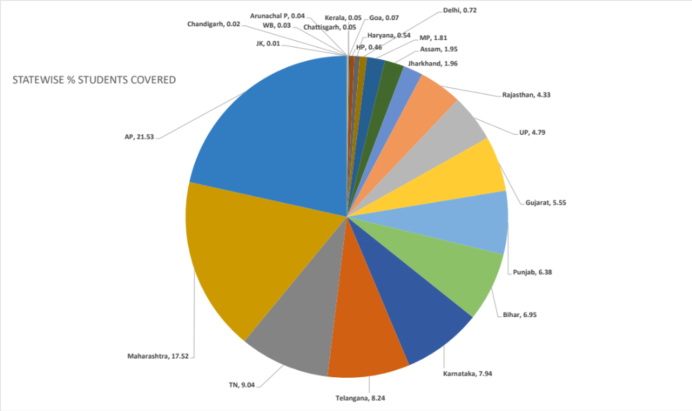
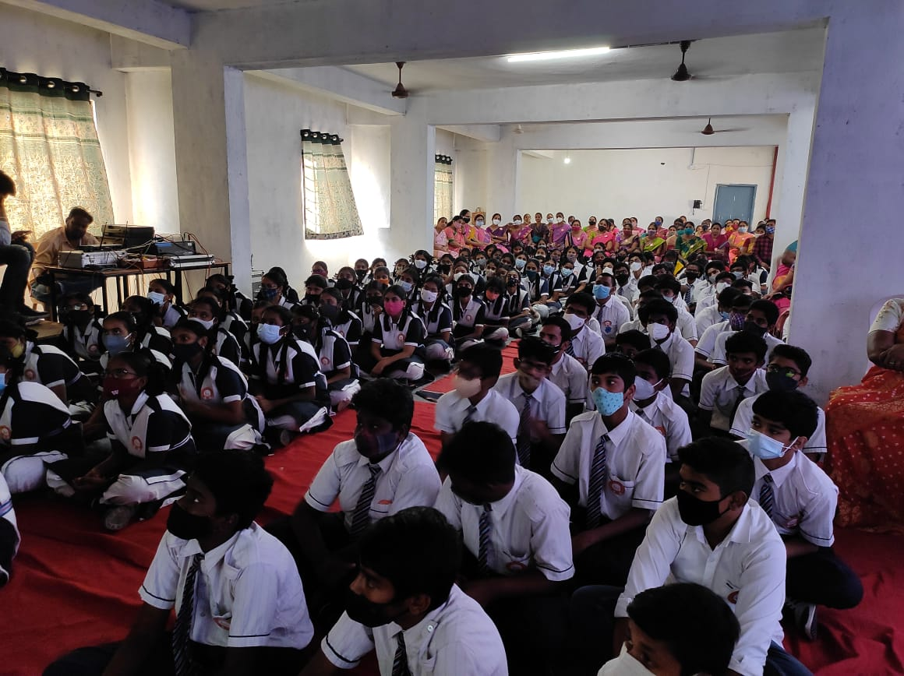
Numbers Speak

Slide 5
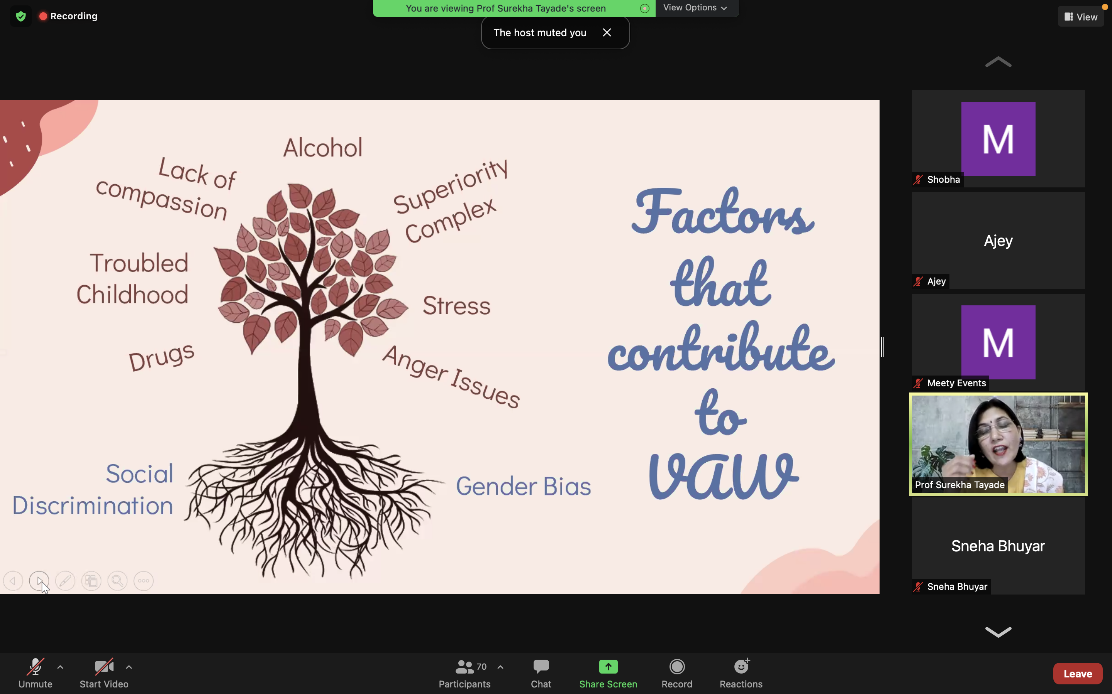
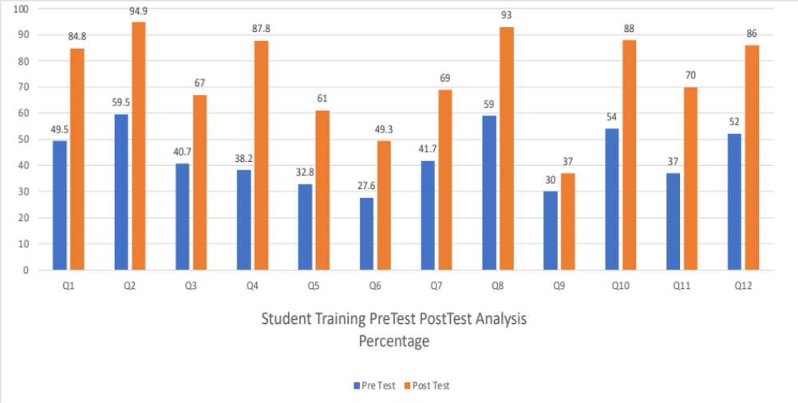
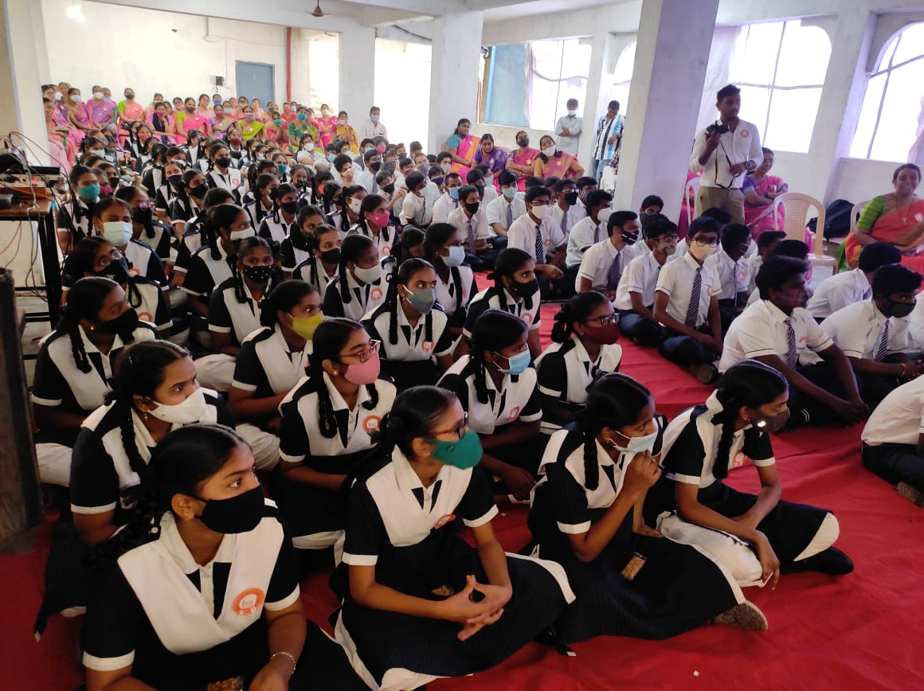
Numbers Speak

Slide 6
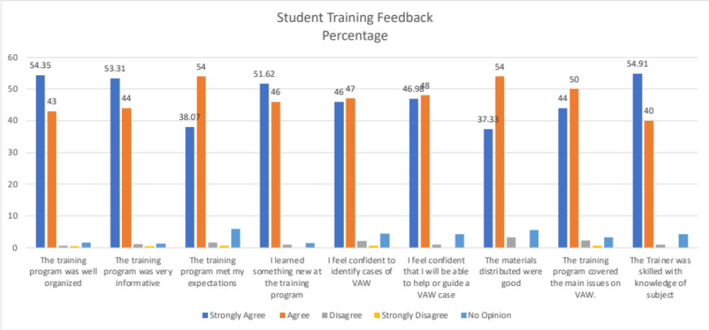
Numbers Speak

Slide 7
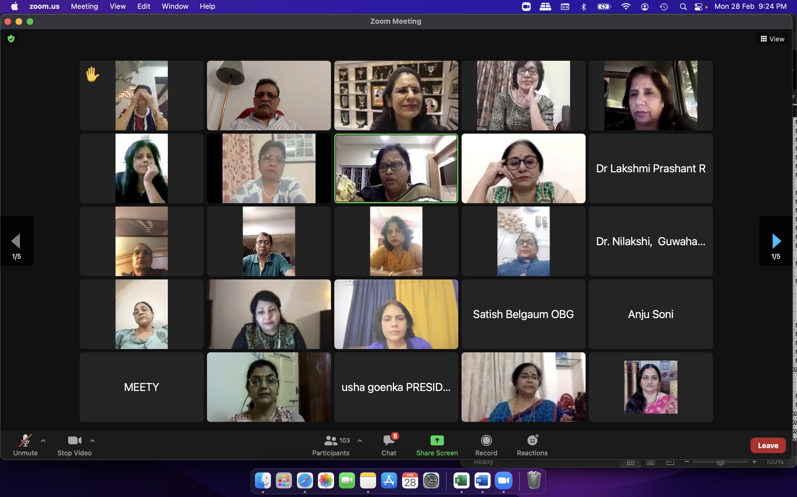
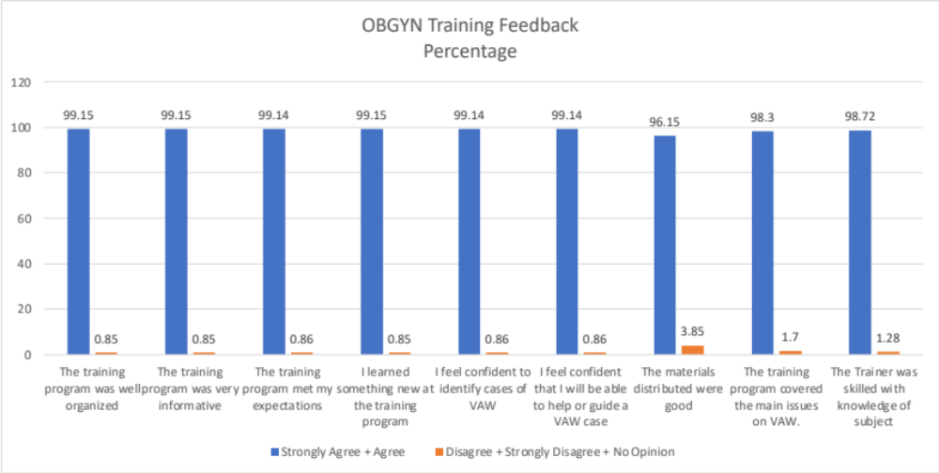
Numbers Speak

